Slide 1
Deinterleaving RADAR pulses
Atos Scientific Community
13/07/2021
Manon Mottier

Slide 2


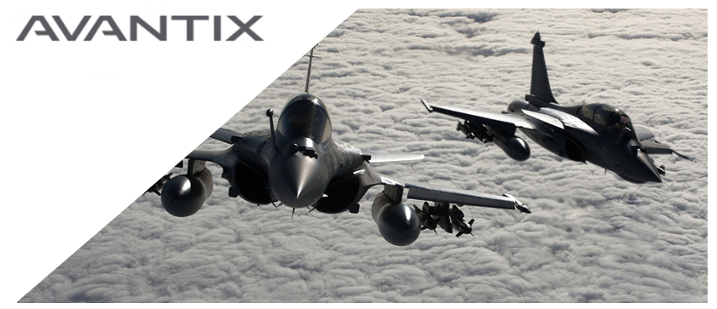
Context
Industrial thesis (CIFRE):
The Signals and System Laboratory of CentraleSupélec
AVANTIX
Phd student, 2nd year
AVANTIX (ATOS Group)
French company specialized in Electronic Warfare
Designs critical high-tech systems to provide homeland protection and military forces
Radar processing chain
    Data processing based on the interception of a signal by a listening system
    Provides strategic information to military platforms
        Identification
        Interpretation of the situation
        Threat asssessment, etc.

Slide 3
Context
The subject:
Use and development of machine learning tools for passive RADAR intelligence
        Improvement of the RADAR deinterlacing chain
Passive RADAR(s)
  Emit no electromagnetic waves
  Only receivers
  Detect, track and identify RADAR(s)
RADAR signals deinterlacing includes techniques capable of:
  Separating
  Characterizing
  Identifying all transmitters present in the signal
To summarize
Data reception
Separation and grouping of data
Comparison of groups to Radar database which contains all the characteristics of the RADARS
Identification of the RADAR present or updating of the database
  RADAR Deinterlacing

Slide 4
Content
Data description
Proposed approach
Results
Conclusion

Slide 5
Data description

Slide 6
Main challenges
Data complexity:
Some RADARs do not continuously transmit
Noisy data, e.g., sensors are not optimal, parasites, weak SNR…
Identifiability issues: Different RADARs may have very close, almost identical, characteristics (e.g., in airports or harbors …)
Volume and heterogeneity: Signals of different sizes (from 50 pulses to more than 1 000 000 pulses) that may contain up to 10 RADAR(s)

Slide 7
Data description
Realistic simulator since real labeled data are not easily accessible
Each dataset is composed of RADAR pulses, described by only 4 features:
  Frequency (F),
  Pulse Width (PW)
  Level (L)
  Time of Arrival (TOA)
Work only from these 4 features
No use the dTOA
No assumption on the waveform
Unsupervised setting but evaluate methods on labeled datasets

Slide 8
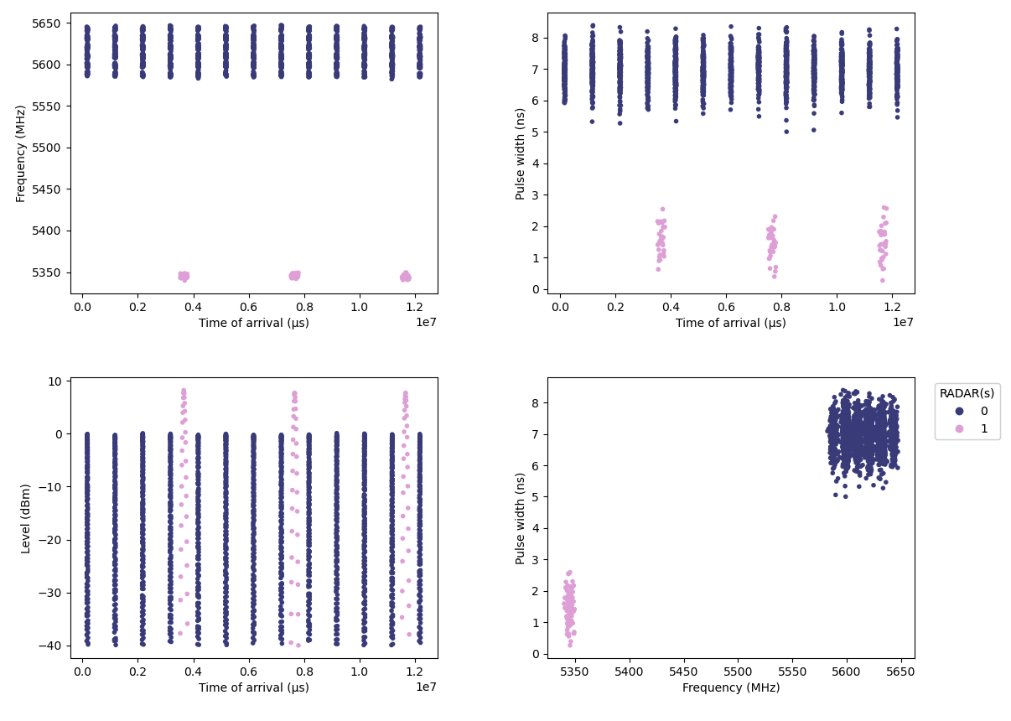
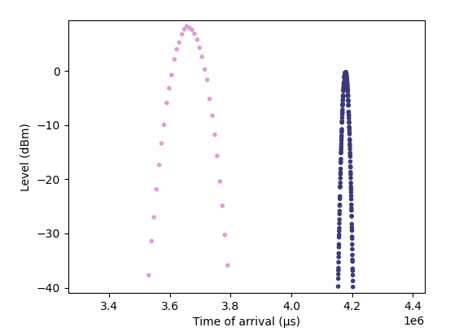
Data description
Example of a simple signal containing 2 RADARs
36 262 pulses
  Radar 0: 34 749 (96%)
  Radar 1: 1 578 (4%)

Slide 9
Proposed Approach

Slide 10
Proposed approach
Methodology: Implementing a two-step strategy for signal deinterlacing
Step 1: Clustering
Step 2: Cluster fusion
Cluster each observation of this signal under the constraint of not merging different radars in one cluster
Hierarchical agglomerative clustering combined with optimal transport distance

Slide 11
Proposed approach
Step 1: Clustering
Step 1: Clustering with HDBSCAN
Application of clustering algorithm on two features: Frequency and Pulse Width
Why HDBSCAN ?
  Unsupervised algorithm that allows us to search for clusters of varying densities
  Few parameters to optimize
Over-estimation of the number of clusters
  Allows to receive RADARs that do not transmit continuously
  Each cluster must not contain the observations of different RADARs

Slide 12
Proposed approach
Step 1: Clustering
HDBSCAN (Hierarchical Density-based spatial clustering of application with noise):
Construction of the distance matrix between the points according to the density space with the Mutual Reachability Distance
Building of the minimal spanning tree from these distances with Prim’s Algorithm
Application of a hierarchical clustering of connected components from this tree
Extraction of the clusters from the condensed tree

Slide 13
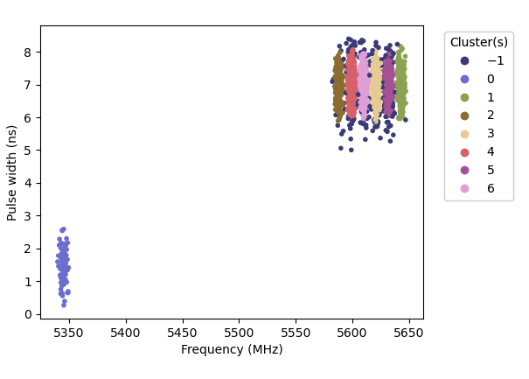
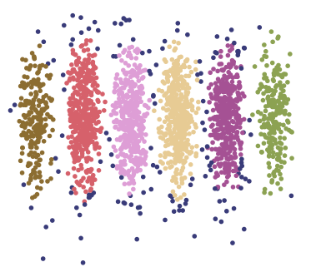
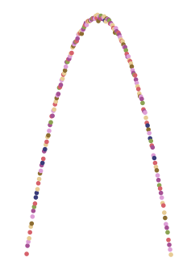
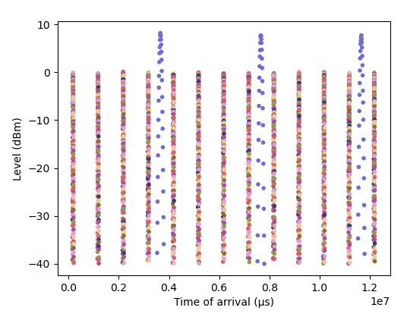
Proposed approach
Step 1: Clustering
Cluster | Pulses | %
-1 | 2 417 | 6,7%
0 | 1 578 | 4,4%
1 | 3 351 | 9,2%
2 | 3 235 | 8,9%
3 | 6 577 | 18,1%
4 | 6 540 | 18%
5 | 6 263 | 17,3%
6 | 6 301 | 17,4%

Slide 14
Proposed approach
Step 2: Cluster fusion
Step 2: Cluster fusion
Development of a hierarchical clustering algorithm using optimal transport distances:
Dimensionality reduction: each cluster is represented by a histogram of its TOA
Compute distances between cluster histograms using optimal transport
Aggregation of the 2 closest clusters i.e., the 2 clusters with the lowest transport costs
Computation of new costs between old clusters and the new ones
Repeat steps 2 to 4 until a single cluster is obtained
Reminder
Hierarchical Agglomerative Clustering consider all points as a singleton cluster and aggregate successively the closest clusters until a single cluster is obtained that groups all points. The fusion steps are given by a dendrogram.

Slide 15
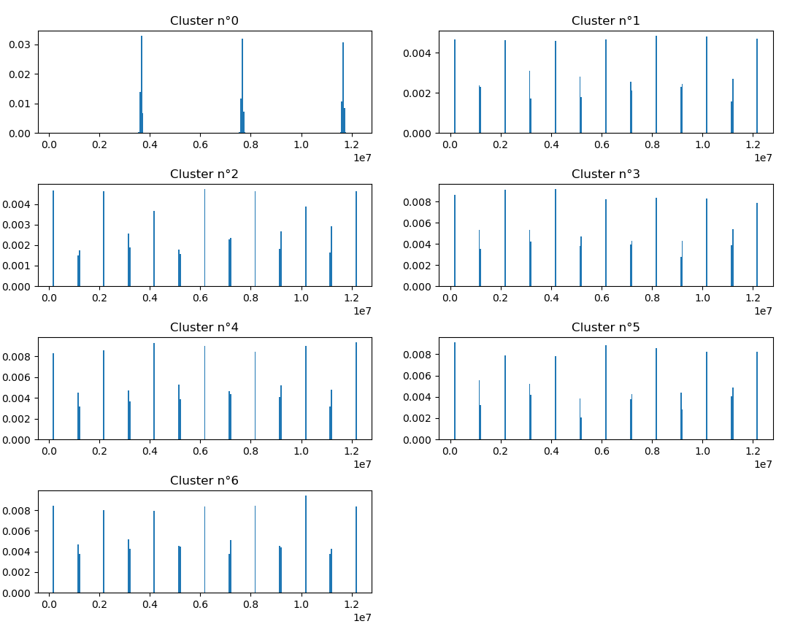
Proposed approach
Step 2: Cluster fusion
Histograms:
Bins: according to the data size (360)
Variable: TOA
Weight: LEVEL
High cost
Low cost

Slide 16


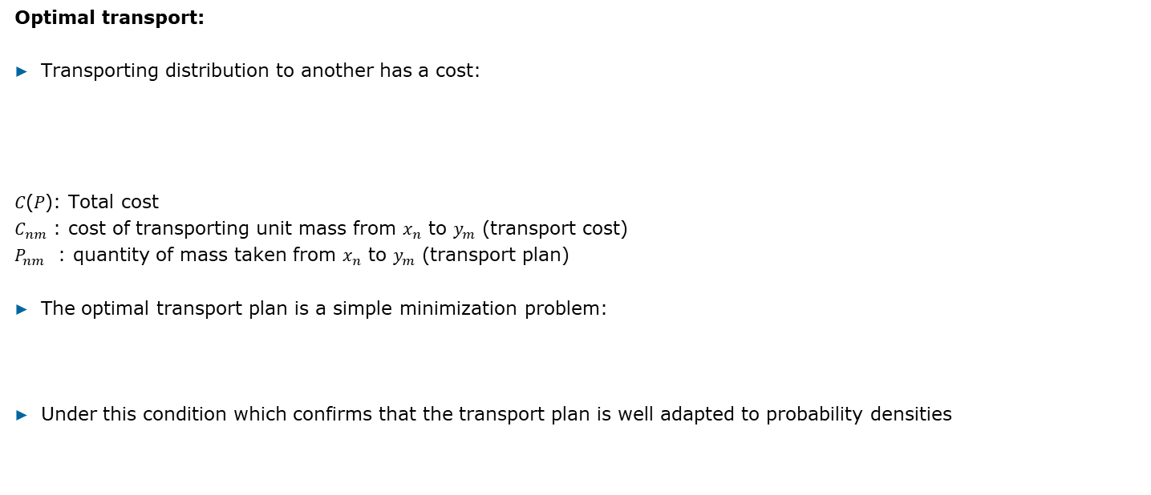
Proposed approach
Step 2: Cluster fusion
Optimal transport:
Transporting distribution to another has a cost:
𝐶(𝑃): Total cost
$C_{nm}$ : cost of transporting unit mass from $x_{n}$ to $y_{m}$ (transport cost)
$P_{nm}$ : quantity of mass taken from $x_{n}$ to $y_{m}$ (transport plan)
The optimal transport plan is a simple minimization problem:
Under this condition which confirms that the transport plan is well adapted to probability densities

Slide 17
Proposed approach
Step 2: Cluster fusion
Construction of a decision model using several unsupervised metrics to cut the dendrogram and stop cluster fusion:
Silhouette score: measures the cluster homogeneity using the difference between all the points in the same cluster and the distance to the points of the other clusters
  Use of 2 different distances for more robustness
Calinski-Harabasz score: measures the proportion of inter-group variance to intra-group variance (also called variance ratio criterion)
Davies-Bouldin score: measures homogeneity using the distance between a point and its centroid and the distance between the other centroids
        Apply Majority rule

Slide 18
Proposed approach
Step 2: Cluster fusion
Higher is better
Lower is better
Number of cluster | Silhouette score (distance euclidean) | Silhouette score (distance cosine) | Calinski-Harabasz score | Davies-Bouldin score
2 | 0,93 | 0,99 | 25 425 | 0,06
3 | 0,42 | 0,03 | 17 882 | 0,72
4 | 0,34 | -0,03 | 12 742 | 0,77
5 | 0,31 | -0,03 | 13 223 | 0,97
6 | 0,47 | -0,03 | 19 062 | 7,98
7 | 0,78 | -0,04 | 362 535 | 0,24

Slide 19
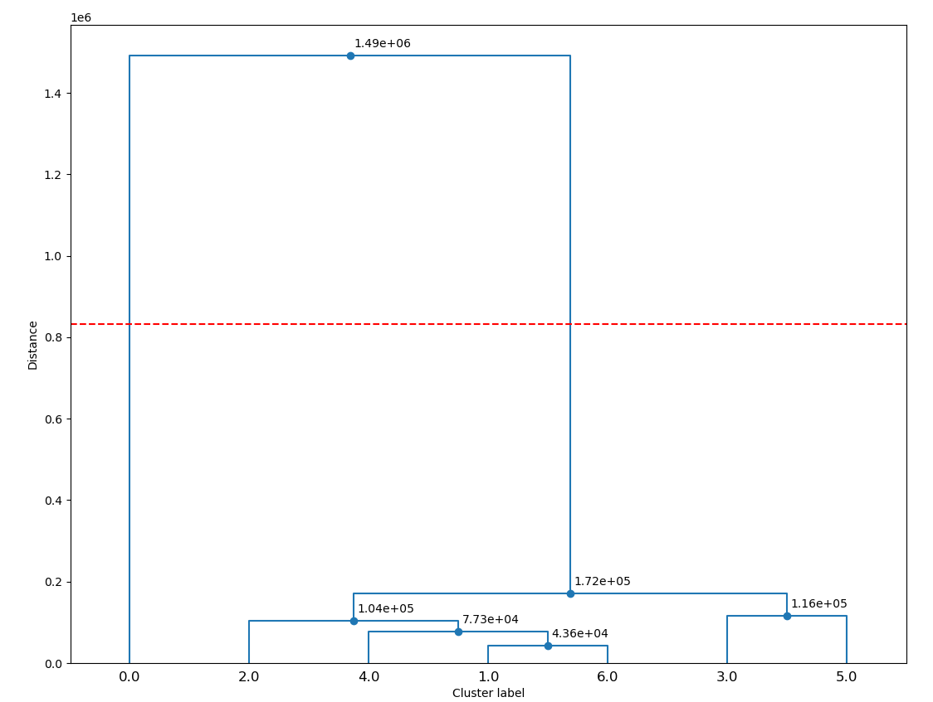
Proposed approach
Step 2: Cluster fusion
Dendrogram
Best cut

Slide 20
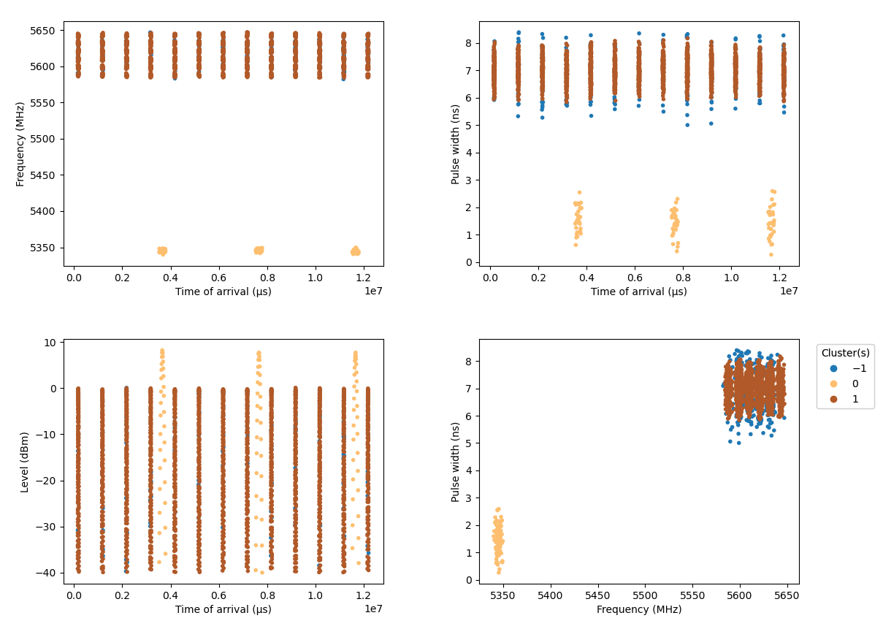
Proposed approach
Step 2: Cluster fusion
Final groupings

Slide 21
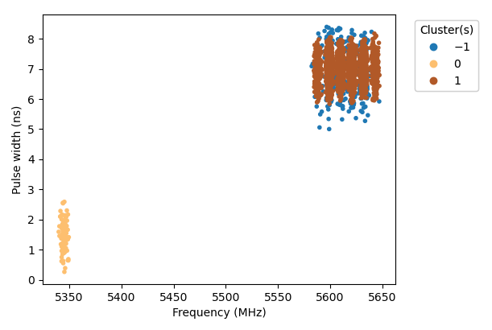
Proposed approach
Step 2: Cluster fusion
Quality of fusion:
Construction of an evaluation model to measure the quality of fusion based on 3 existing criteria:
Homogeneity: measures if all points from a given cluster belong to the same class (varies between 0 and 1, 1 indicating a perfect homogeneity within the cluster)
Completeness: measures if all points of a given class are grouped in a single cluster (varies between 0 and 1, 1 indicating no dispersion of the class data among several clusters)
Unclassified rate: measures the amount of data that is lost in the process
Statistics | Value
Homogeneity | 1
Completeness | 1
Unclassified rate | 6,3%

Slide 22
Results

Slide 23
Application case 1

Slide 24
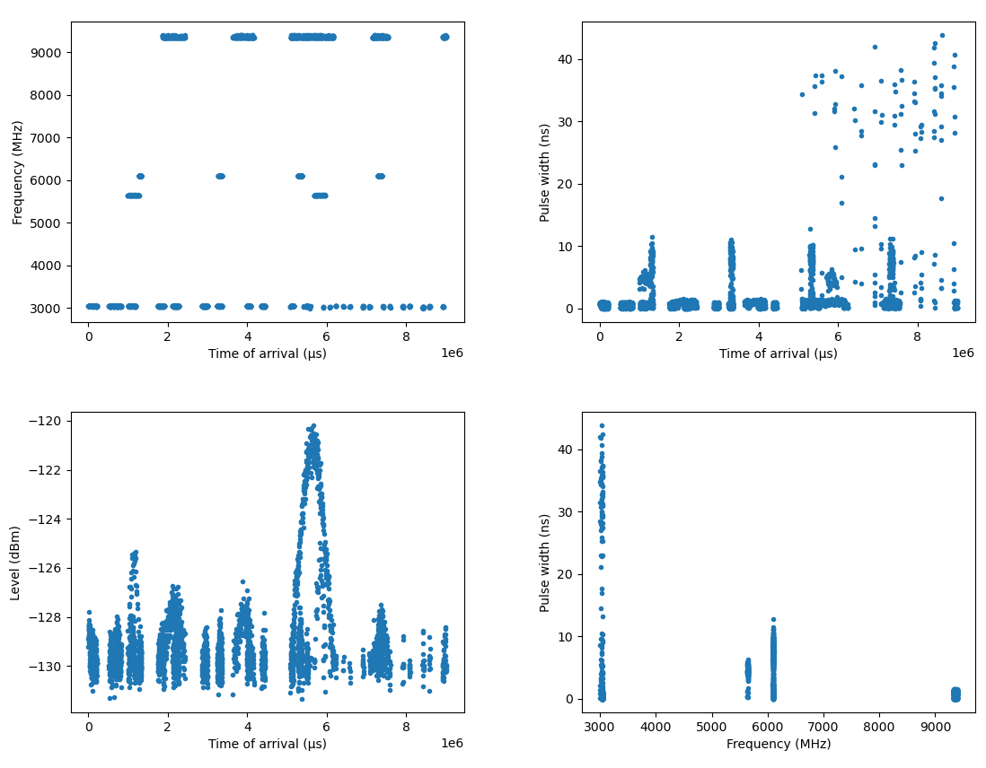
Initial data
3 330 pulses
5 Radars
  2 transmit on the same frequency band (around 3000 MZ)
  Slight spread of the pulse width

Slide 25
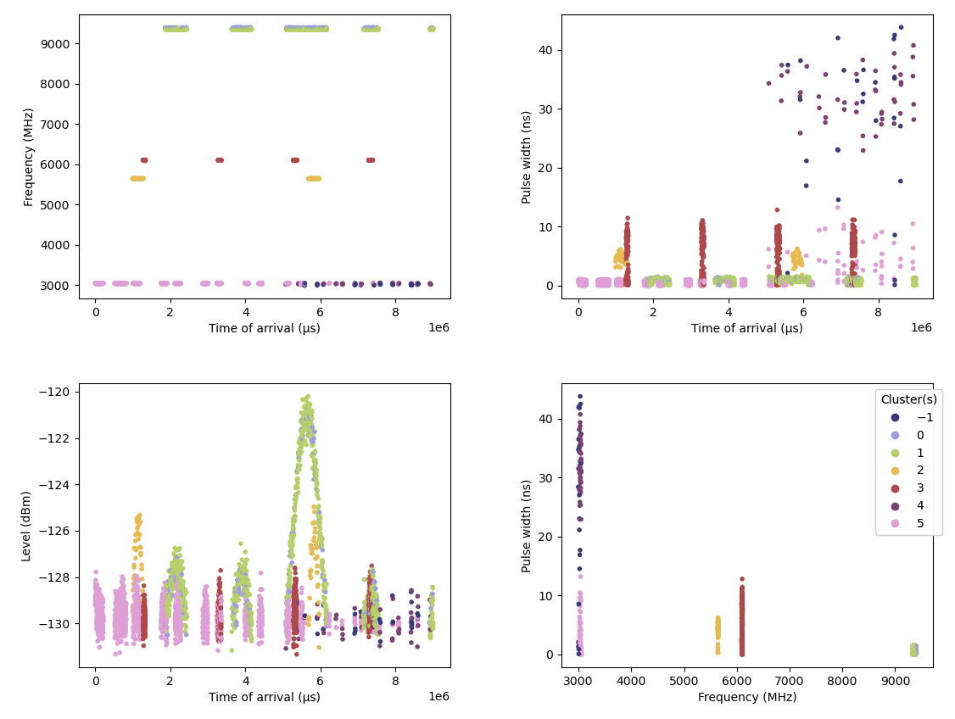
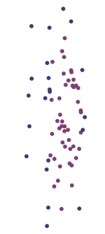
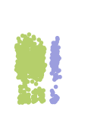
Step 1: Clustering
HDBSCAN
Cluster | Pulses | %
-1 | 29 | 0,9
0 | 149 | 4,5
1 | 731 | 22
2 | 78 | 2,3
3 | 531 | 15,9
4 | 45 | 1,4
5 | 1 767 | 53,1

Slide 26
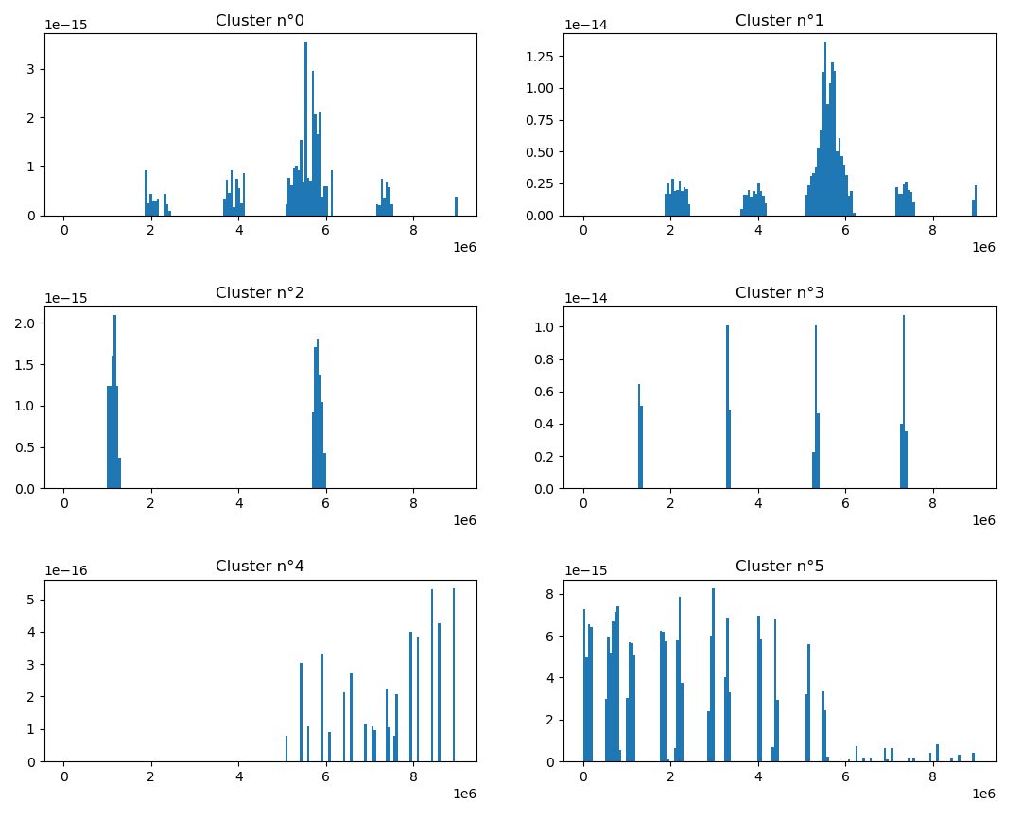
Step 2: Cluster fusion
Histograms
Low cost
Bins: according to the data size (166)
Variable: TOA
Weight: LEVEL
High cost

Slide 27
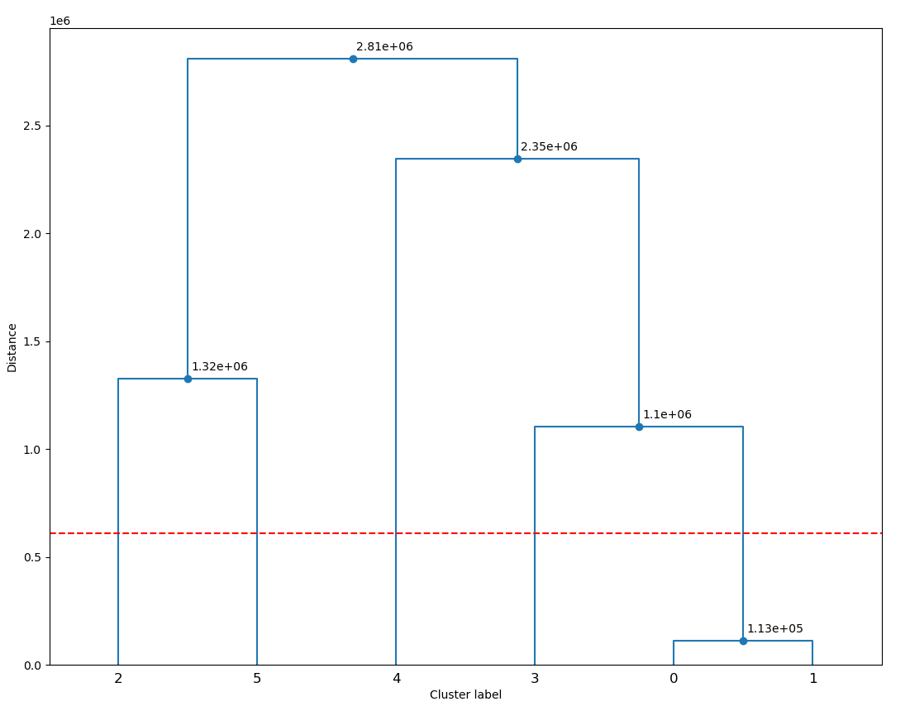
Step 2: Cluster fusion
Dendrogram
Best cut

Slide 28

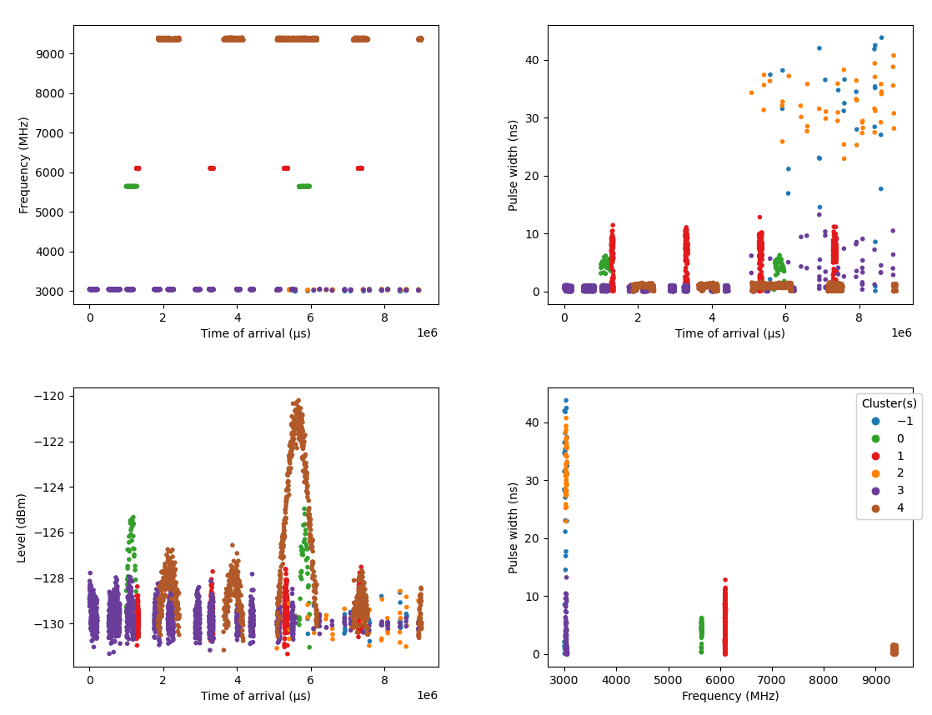
Step 2: Cluster fusion
Final groupings
The pulses of the 2 transmitters around 3000MH are mixed
Hdbscan can not differentiate them at step 1
Statistics | Value
Homogeneity | 0,94
Completeness | 0,98
Unclassified rate | 0,9%

Slide 29
Application case 2

Slide 30
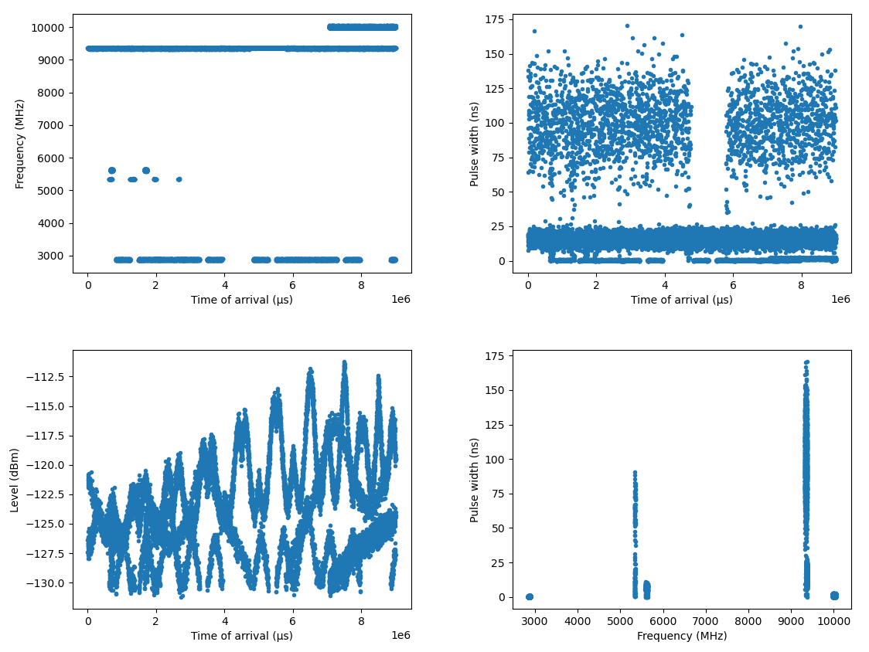
Initial data
More complex signal
16 023 pulses
6 Radars
Strong spread of the pulse width

Slide 31
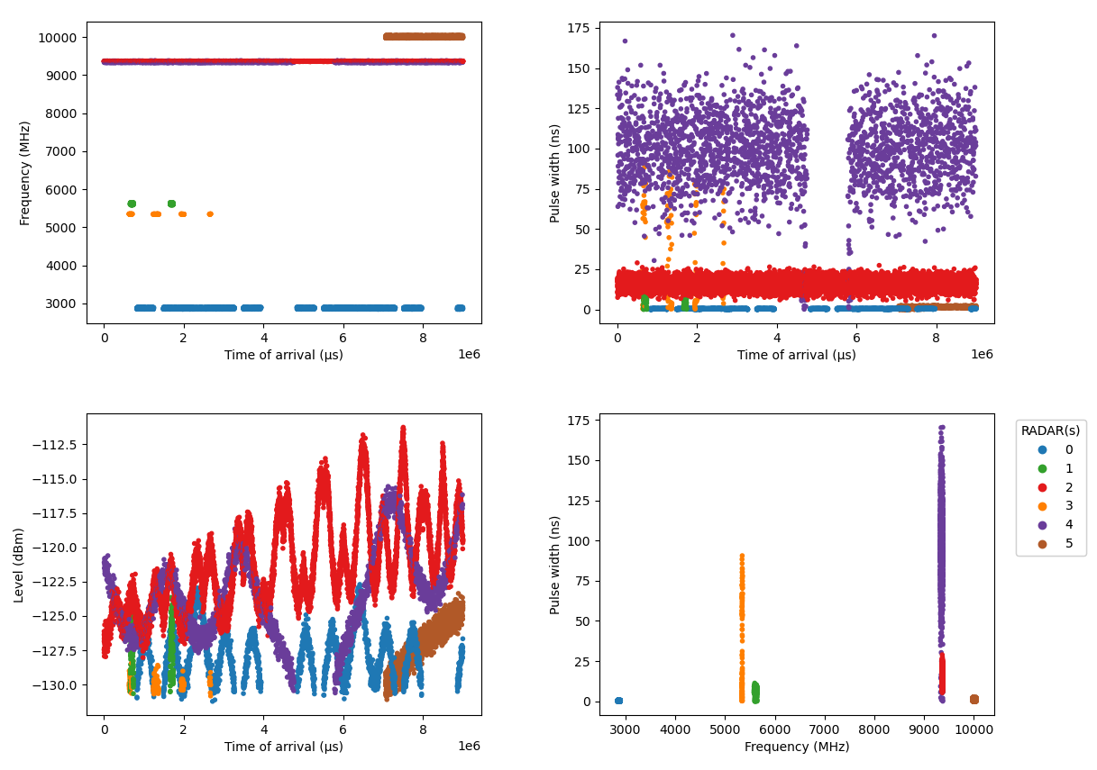
Step 2: Cluster fusion
True label

Slide 32
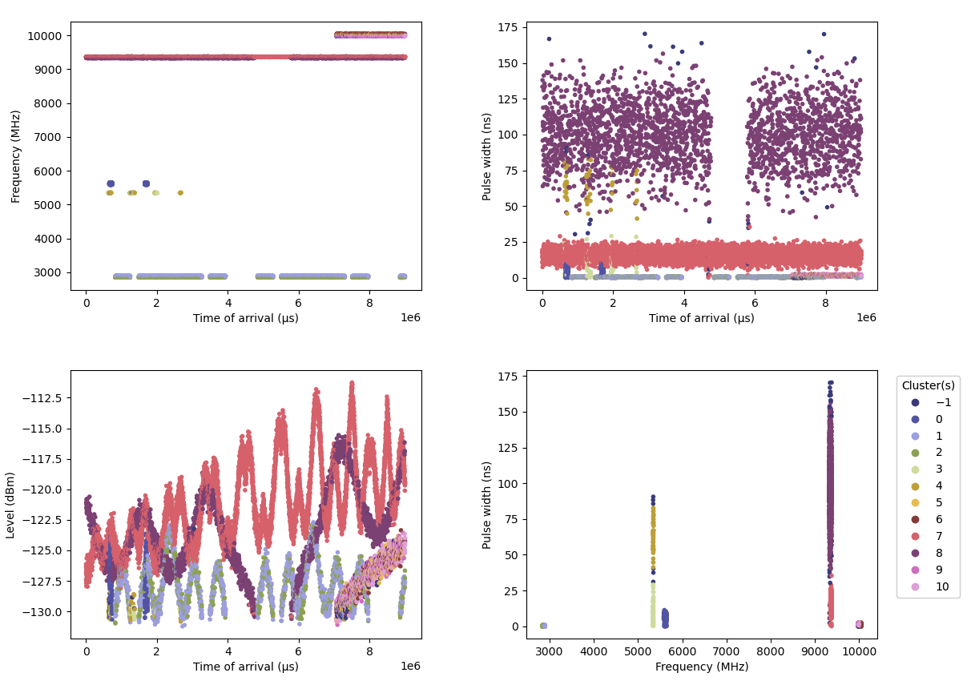
Step 1: Clustering
HDBSCAN
Cluster | Pulses | %
-1 | 176 | 1,1
0 | 293 | 1,8
1 | 1 684 | 10,5
2 | 821 | 5,1
3 | 76 | 0,5
4 | 55 | 0,3
5 | 422 | 2,6
6 | 286 | 1,8
7 | 8 831 | 55,1
8 | 2 268 | 14,2
9 | 409 | 2,6
10 | 702 | 4,4

Slide 33
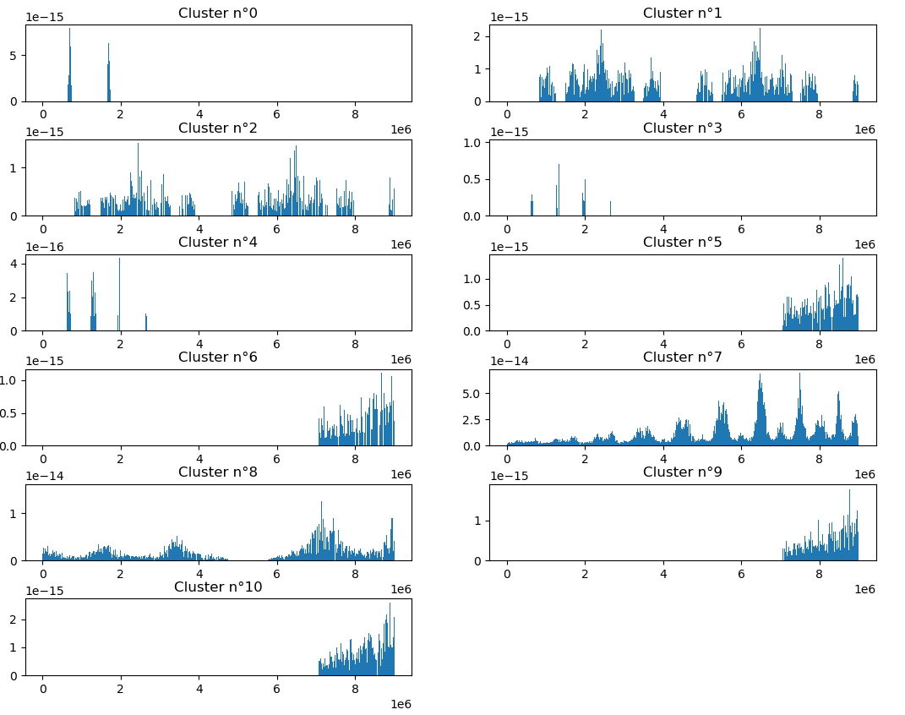
Step 2: Cluster fusion
Histograms
Bins: according to the data size (801)
Variable: TOA
Weight: LEVEL
High cost
Low cost

Slide 34
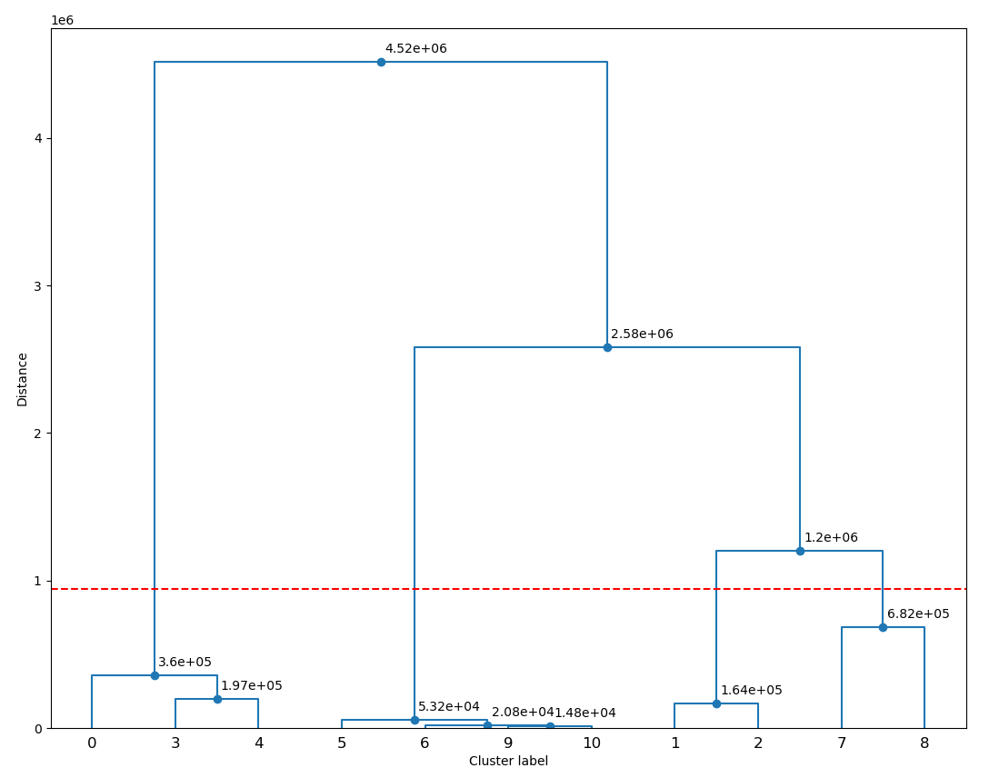
Step 2: Cluster fusion
Dendrogram
Best cut

Slide 35
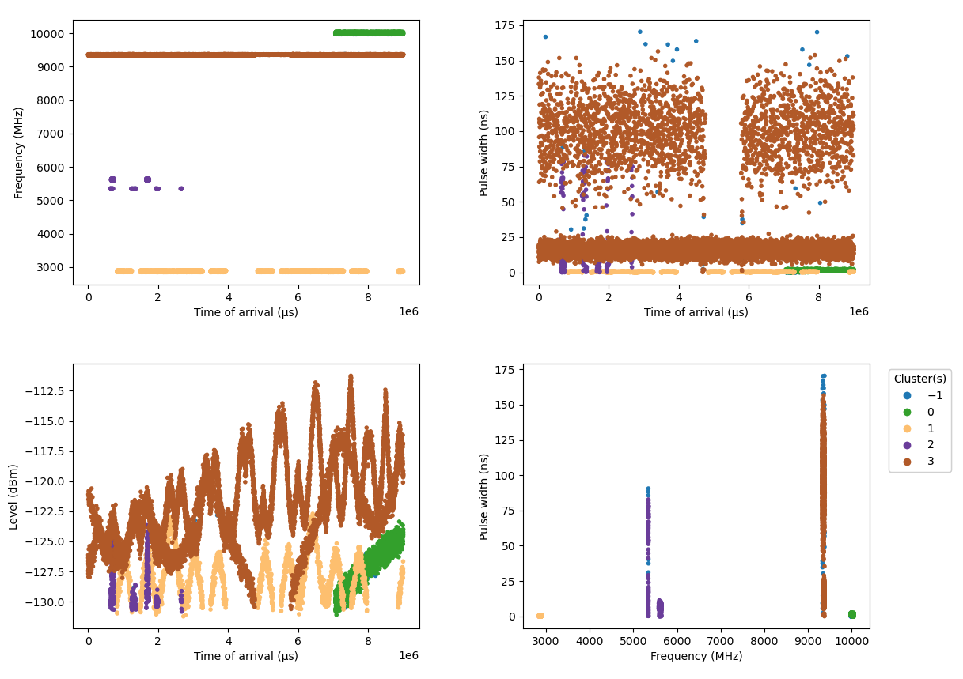
Step 2: Cluster fusion
Final grouping
Underestimation of Radar number
Not a problem because the results from the dendrogram are good
  Improve the model decision to cut the dendrogram
Statistics | Value
Homogeneity | 0,7
Completeness | 1
Unclassified rate | 1,1%

Slide 36
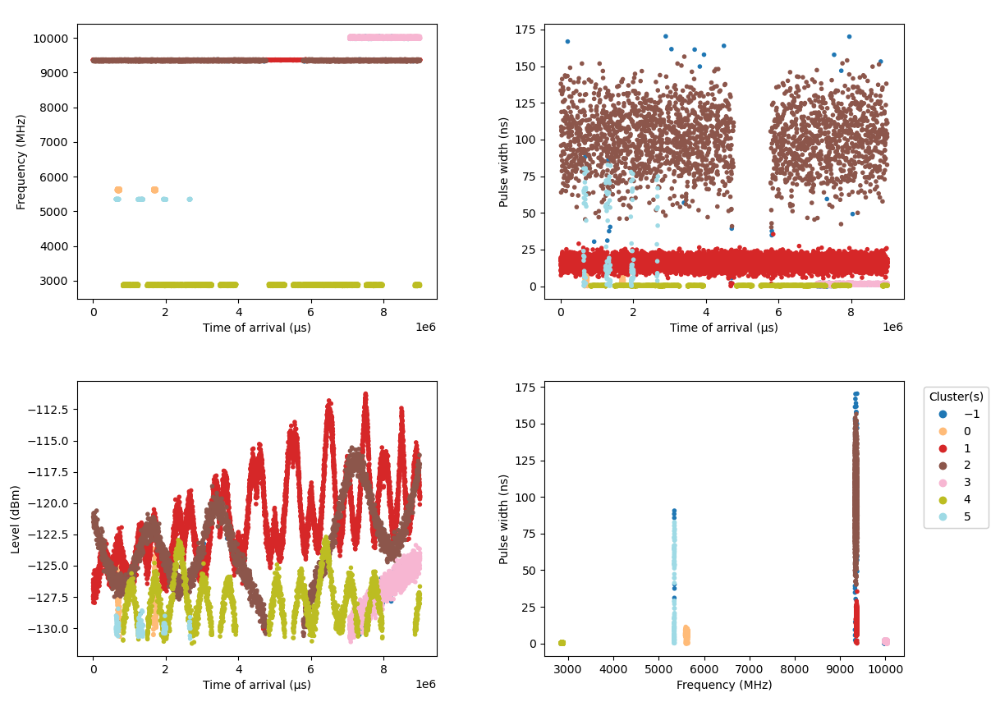
Step 2: Cluster fusion
Final grouping
Groupings with the true number of Radars using the previous dendrogram
Groupings are good
Only 22 pulses are mixed
Statistics | Value
Homogeneity | 0,9
Completeness | 1
Unclassified rate | 1,1%

Slide 37
Conclusion

Slide 38
Conclusions and Next objectives
Works on moderately complex cases
Publication of a research article: “Deinterleaving and Clustering unknown RADAR pulses” - Manon Mottier; Gilles Chardon; Frédéric Pascal
Next objectives
  Clustering: Define a metric to identify identical RADARs in Frequency and Pulse Width
  Improve model decision to cut the dendrogram:
    Create a new metric
    Use alternative methods (LSTM)
  Classification and RADAR identification from a reference database

Slide 39
Thank you
For more information please contact:
Manon MOTTIER
manon.mottier@atos.net

