Slide 1
Passive RADAR: Deinterleaving and Clustering unknown RADAR pulses
Manon Mottier
02 March 2021

Slide 2
Content
Introduction
Data description
Proposed approach
Results
Conclusion

Slide 3


Introduction
Context
      Use and development of machine learning tools in the field of Electronic Warfare specifically for passive RADAR intelligence
      Improvement of RADAR signal processing thanks to ML approaches
      Passive RADAR(s)
            Emit no electromagnetic waves
            Only receivers
            Detect, track and identify RADAR(s)
      RADAR signals deinterlacing includes techniques capable of separating, characterizing and identifying all transmitters present in the signal
Notes:
Electronic warfare is a key element in modern battles. It must be considered as much for the protection of one's own troops as for the disruption of enemy sensors and communications. Each adversary uses active and passive methods to attack the other's systems.
Extensive electronic eavesdropping networks, maintained by several countries, track land, sea, and air emissions to monitor the wavelengths used by their potential enemies and allow them to jam them in a variety of ways.

Slide 4
Introduction
Main challenges: data complexity
      Some RADARs do not continuously transmit
      Noisy data, e.g., sensors are not optimal, parasites, weak SNR…
      Identifiability issues: Different RADARs may have very close, almost identical, characteristics (e.g., in airports or harbours …)
      Volume and heterogeneity: Signals of different sizes (from 50 observations to more than 1 000 000 observations) that may contain up than 10 RADAR(s)

Slide 5
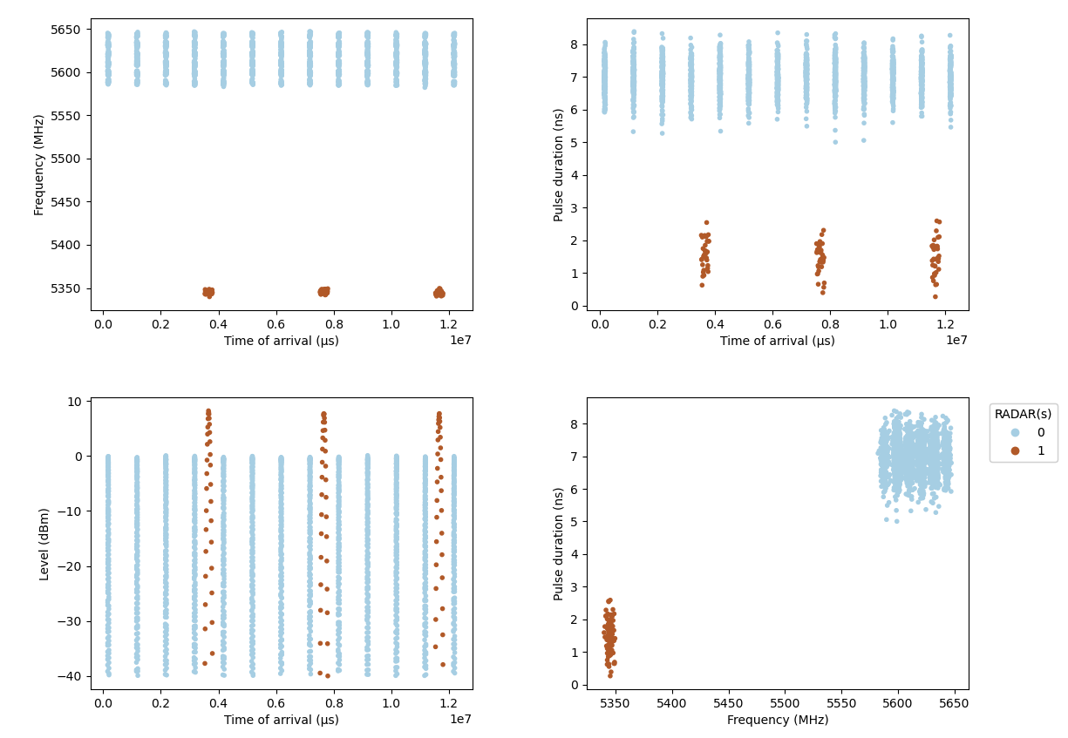
Data Description
Realistic simulator since real labeled data are not easily accessible
Each dataset is composed of RADAR pulses, described by 4 features: Frequency (F), Pulse Width (PW), Level (L) and Time of Arrival (TOA)
Example of a simple signal containing 2 RADAR(s)
    They emit on very different frequency bands and in a regular way
RADAR | Obs | %
0 | 34 684 | 96%
1 | 1 578 | 4%
36 262

Slide 6
Proposed approach
Methodology : Implementing a two-step strategy for signal deinterlacing
Step 1: Clustering
Step 2: Cluster fusion
Cluster each observation of this signal under the constraint of not merging different radars in one cluster
Hierarchical agglomerative clustering combined with optimal transport distance

Slide 7
Proposed approach
Step 1: Clustering with HDBSCAN
Application of clustering algorithm on two features: Frequency and Pulse Width
      Why HDBSCAN ?
            Unsupervised algorithm that allows us to search for clusters of varying densities
            Few parameters to optimize
Over-estimation of the number of clusters
            Allows to receive RADARs that do not transmit continuously
            Each cluster must not contain the observations of different RADARs

Slide 8
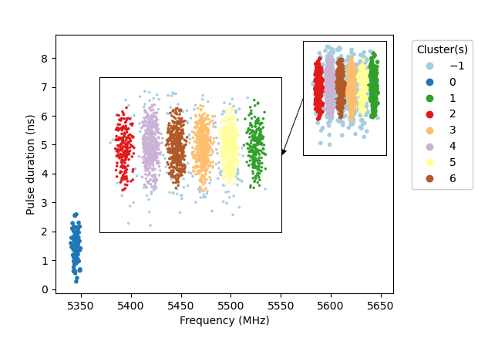
Proposed approach
Step 1: Clustering with HDBSCAN
Clusters label | Obs | %
-1 (outliers) | 2 417 | 7%
0 | 1 578 | 4%
1 | 3 351 | 9%
2 | 3 235 | 9%
3 | 6 577 | 18%
4 | 6 540 | 18%
5 | 6 263 | 17%
6 | 6 301 | 17%
Clusters repartition
Results of HDBSCAN clustering in the F-PW plane.
Notes:
36 262 observations
Radar 0 : 34 684 obs (Bleu)
Radar 1 : 1 1578 obs ( marron)

Slide 9
Proposed approach
Step 2: Cluster fusion
Development of a hierarchical clustering algorithm using optimal transport distances
  Dimensionality reduction: each cluster is represented by a histogram of its TOA
  Compute distances between cluster histograms using optimal transport
  Aggregation of the 2 closest clusters i.e., the 2 clusters with the lowest transport costs
  Computation of new costs between old clusters and the new ones
  Repeat

Slide 10
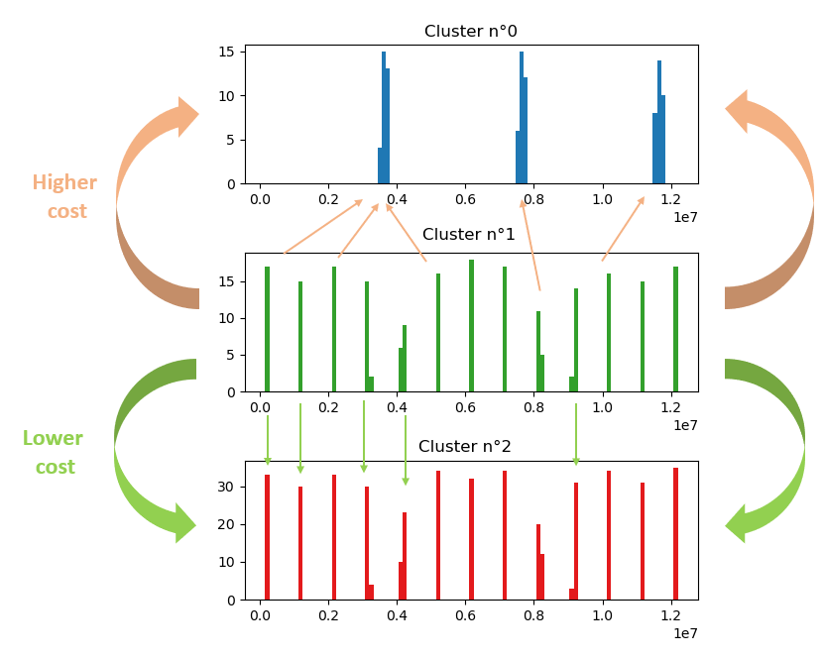


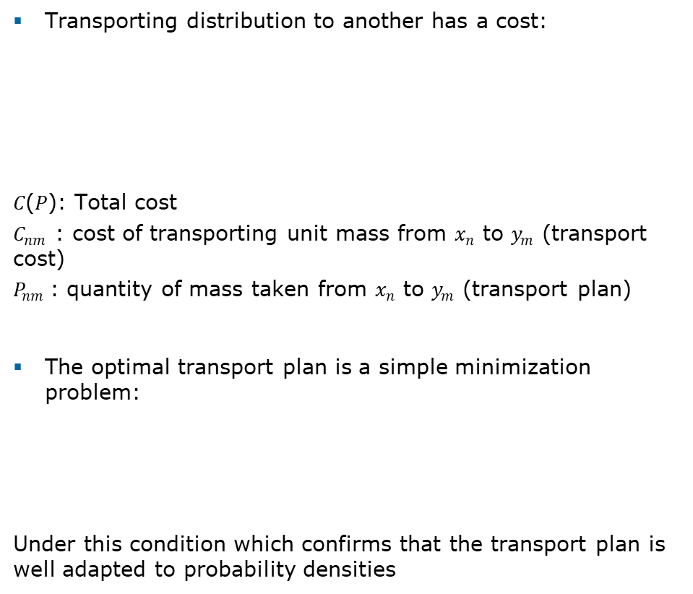
Proposed approach
Transporting distribution to another has a cost:
𝐶(𝑃): Total cost
$C_{nm}$ : cost of transporting unit mass from $x_{n}$ to $y_{m}$ (transport cost)
$P_{nm}$: quantity of mass taken from $x_{n}$ to $y_{m}$ (transport plan)
The optimal transport plan is a simple minimization problem:
Under this condition which confirms that the transport plan is well adapted to probability densities
  Histogram = proportion of observation distributed in each bin for a cluster

Slide 11
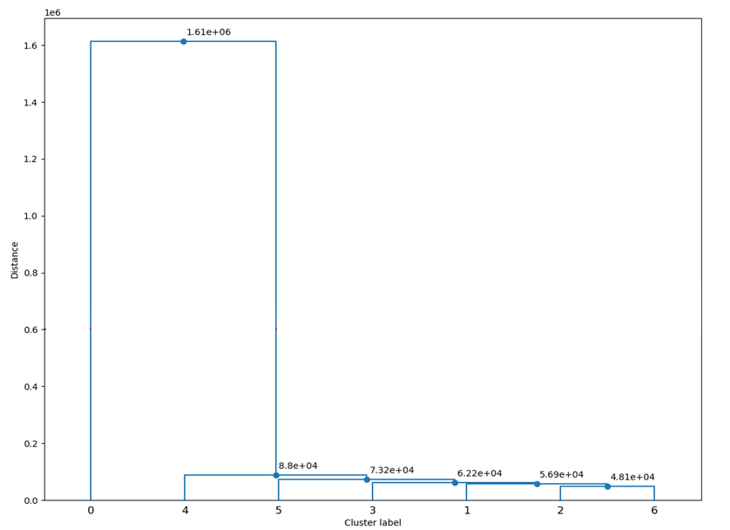
Proposed approach
Step 2: Cluster fusion
Construction of a decision rule using several unsupervised metrics to cut the dendrogram
    Silhouette score
    Calinski-Harabasz score
    Davies-Bouldin score
-> Majority rule

Slide 12
Proposed approach
Higher score
Lower score
Number of clusters | Silhouette score (euclidean distance) | Silhouette score (cosine distance) | Calinski-Harabasz score | Davies-Bouldin score
2 | 0,93 | 0,99 | 25 425 | 0,06
3 | 0,32 | 0,09 | 17 157 | 0,49
4 | 0,19 | -0,03 | 14 206 | 0,68
5 | 0,33 | -0,03 | 11 183 | 1,35
6 | 0,56 | -0,03 | 42 746 | 1,36
7 | 0,77 | -0,03 | 362 535 | 0,24
Notes:
Expliquer que certains se maximise et d’autres minimisent
https://towardsdatascience.com/cheat-sheet-to-implementing-7-methods-for-selecting-optimal-number-of-clusters-in-python-898241e1d6ad

Slide 13
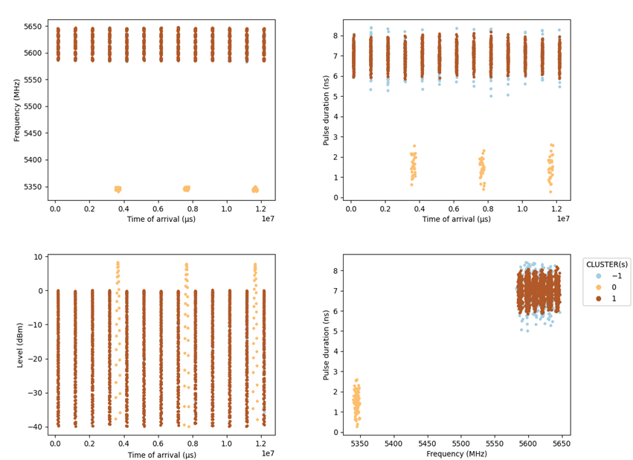
Proposed approach
Perfect clustering and grouping
Outlier class
RADAR | Obs | %
-1 | 2 417 | 7%
0 | 1 578 | 4%
1 | 32 267 | 89%
- 7%
Emmiters repartition
Results of clusters fusion after HAC with optimal transport distances.

Slide 14
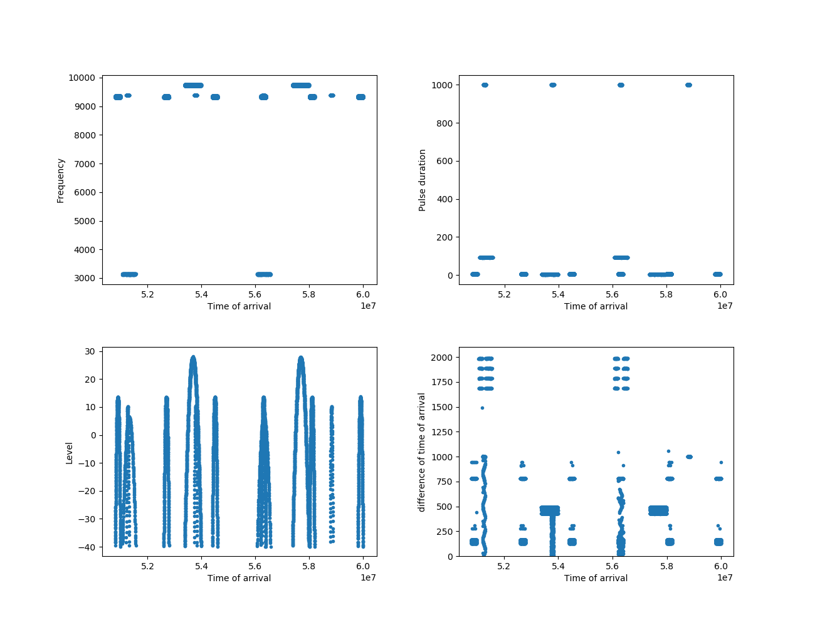
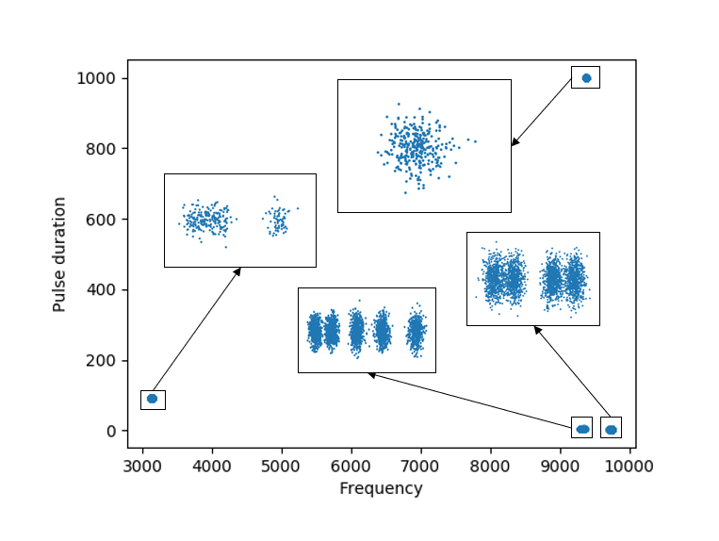
Application case 1
Notes:
Clusters Obs %
0 8 199 5,3%
1 65 435 42,5%
2 69 509 45,2%
3 10 797 7%
153 940
A zoom has been applied to facilitate its visualization. The DTOA has been calculated on the whole signal.

Slide 15
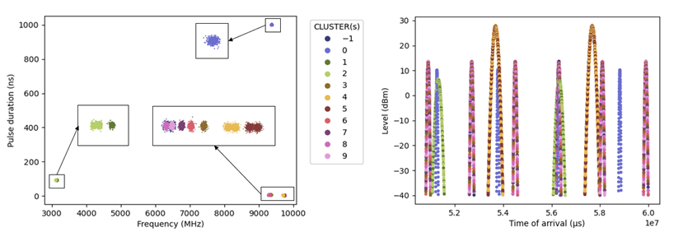
Application case 1
Clusters | Obs | %
-1 | 954 | 1%
0 | 8 199 | 5%
1 | 2 703 | 2%
2 | 8 094 | 5%
3 | 13 907 | 9%
4 | 32 704 | 21%
5 | 32 726 | 21%
6 | 13 892 | 9%
7 | 13 891 | 9%
8 | 13 502 | 9%
9 | 13 368 | 9%
Results of HDBSCAN clustering

Slide 16
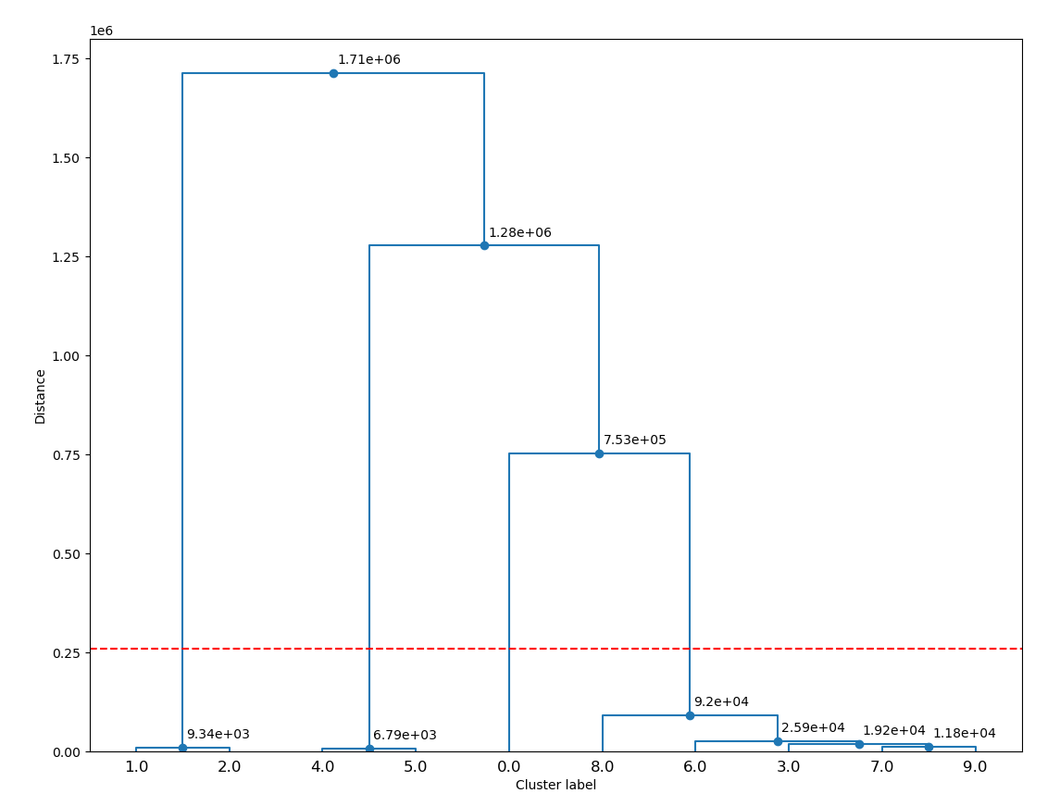
Application case 1
Higher score
Lower score
Number of clusters | Silhouette score (euclidean) | Silhouette score (cosine) | Calinski-Harabasz score | Davies-Bouldin score
2 | 0,96 | 0,20 | 225 665 | 0,044
3 | 0,79 | -0,10 | 199 414 | 0,323
4 | 0,95 | 0,89 | 22 699 186 | 0,041
5 | 0,66 | 0,42 | 24 383 075 | 0,229
6 | 0,56 | 0,42 | 19 966 460 | 0,985
7 | 0,79 | 0,41 | 40 515 795 | 0,248
8 | 0,89 | 0,40 | 40 049 740 | 0,169
9 | 0,87 | 0,35 | 39 582 412 | 0,203
10 | 0,80 | 0,03 | 200 066 228 | 0,24

Slide 17
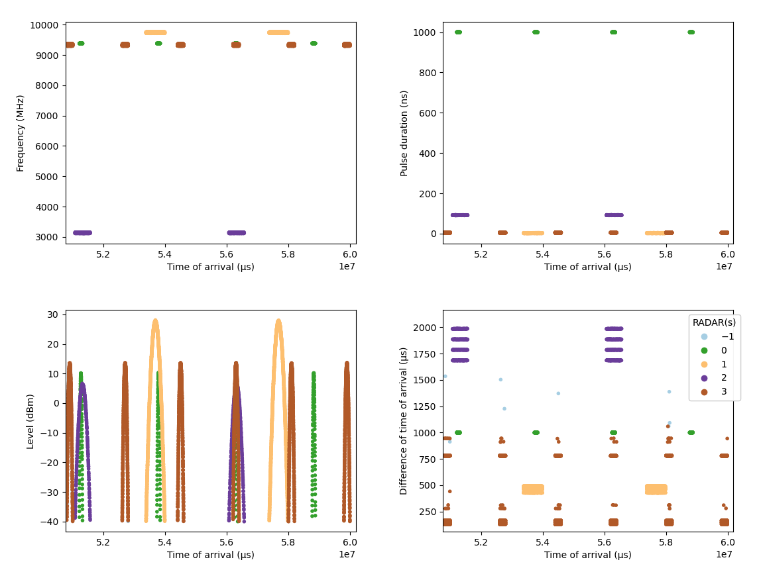
Application case 1
RADAR(s) | Obs | %
0 | 8 199 | 5,3%
1 | 65 430 | 42,5%
2 | 10 797 | 7%
3 | 68 560 | 44,5%
-1 (outliers) | 954 | 0,6%
- 0,01%
- 1,4%
Notes:
Radar 3 : - 949
Radar 1 : -5
Radar names are interved for 2 and 3

Slide 18
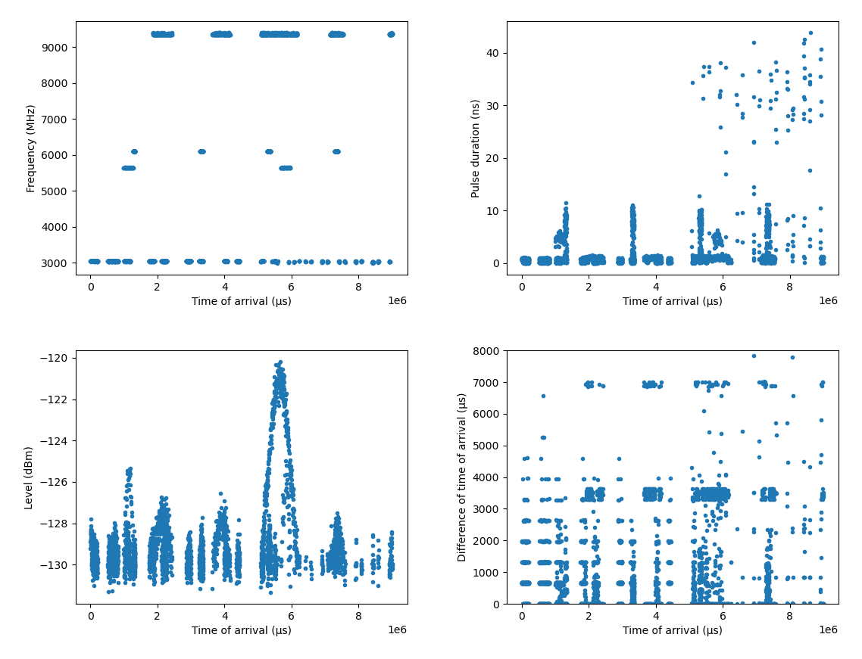
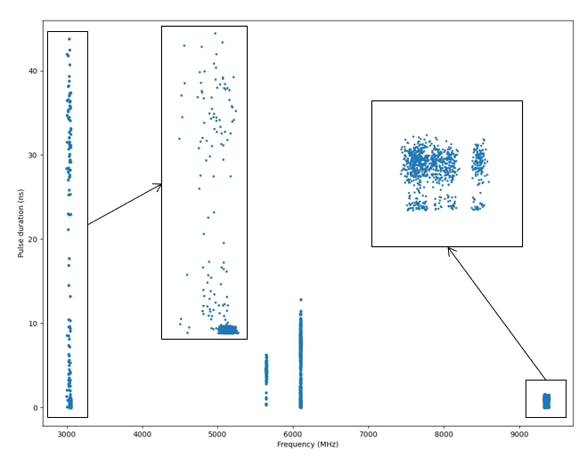
Application case 2

Slide 19
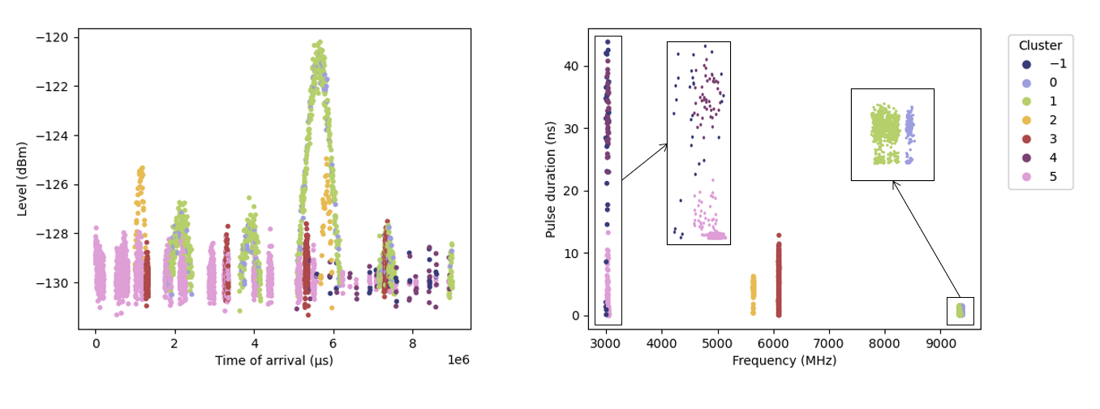
Application case 2
Clusters | Obs | %
-1 | 29 | 1%
0 | 149 | 4%
1 | 731 | 22%
2 | 78 | 2%
3 | 531 | 16%
4 | 45 | 1%
5 | 1767 | 53%
Results of HDBSCAN clustering

Slide 20
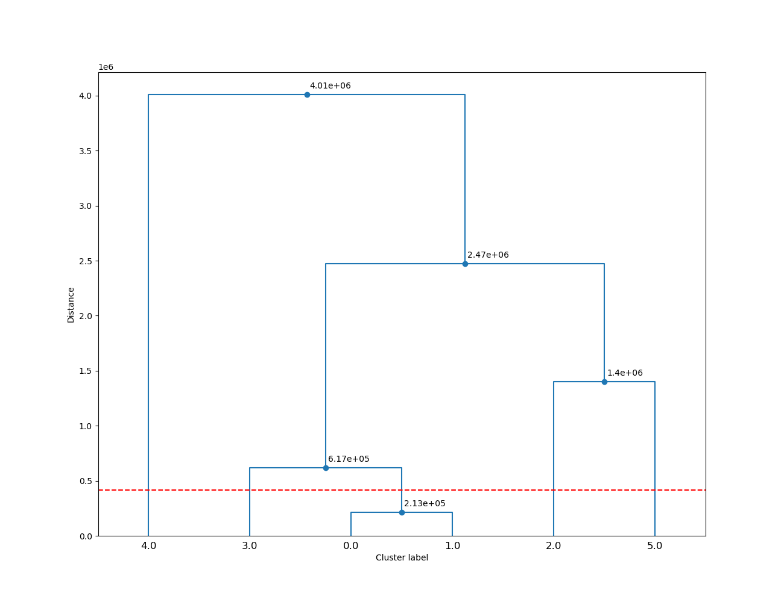
Application case 2
Higher score
Lower score
Number of clusters | Silhouette score (euclidean) | Silhouette score (cosine) | Calinski-Harabasz score | Davies-Bouldin score
2 | -0,39 | 1,00 | 32 | 1,08
3 | -0,10 | 0,15 | 8 226 | 1,30
4 | 0,56 | 0,08 | 6 430 | 0,48
5 | 0,93 | -0,26 | 60 326 530 | 0,14
6 | 0,84 | -0,5 | 115 727 201 | 0,22

Slide 21
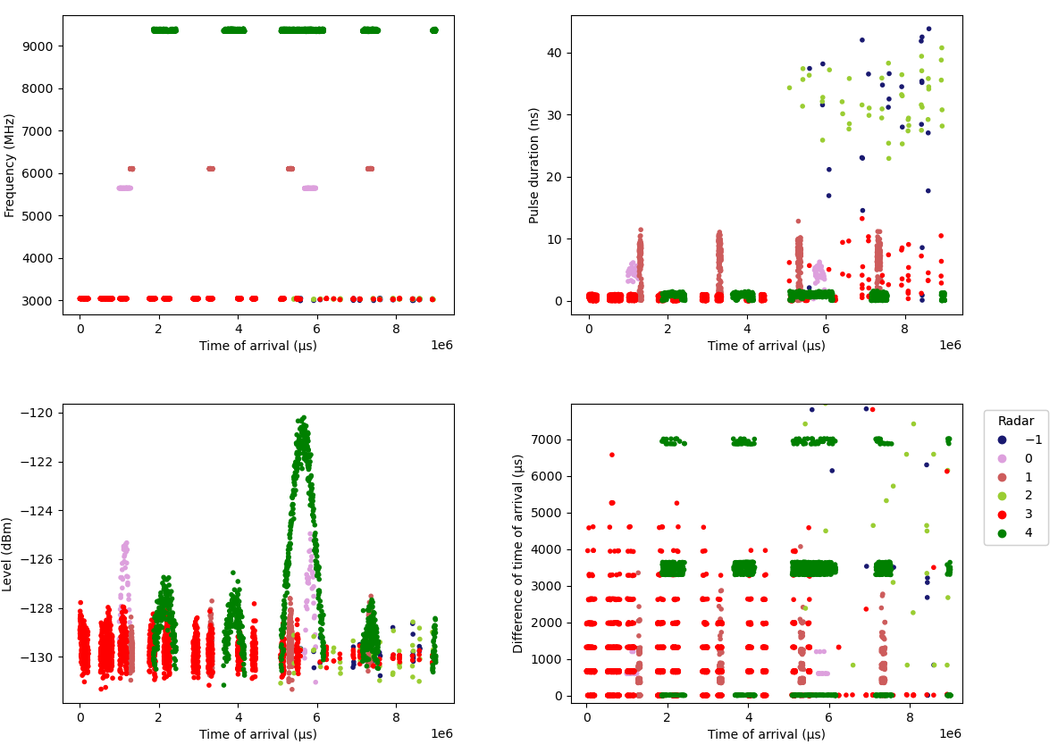
Application case 2
RADAR(s) | Obs | %
0 | 78 | 2%
1 | 531 | 16%
2 | 45 | 1%
3 | 1 767 | 53%
4 | 880 | 26%
-1 (outliers) | 29 | 1%
Notes:
3 : impulsions de 2 RADARS différents
2 : impulsions d’un seul RADARs mais il en manque et elles sont dans le 3 (47)
Le RADAR 2 est éclaté dans les clusters -1, 2 et 3
-1 : impulsions d’un seul RADAR du 2
Le RADAR 2 est éclaté dans les clusters -1, 2 et 3

Slide 22
Conclusion
Works on moderately complex cases
Improvements in progress to differentiate between similar RADAR(s) in Frequency and Pulse Width
Next objectives:
      Cluster representativeness: size, distribution, etc.
      RADAR with a strong frequency sweep
      Construction of a decision model to cut the dendrogram

Slide 23
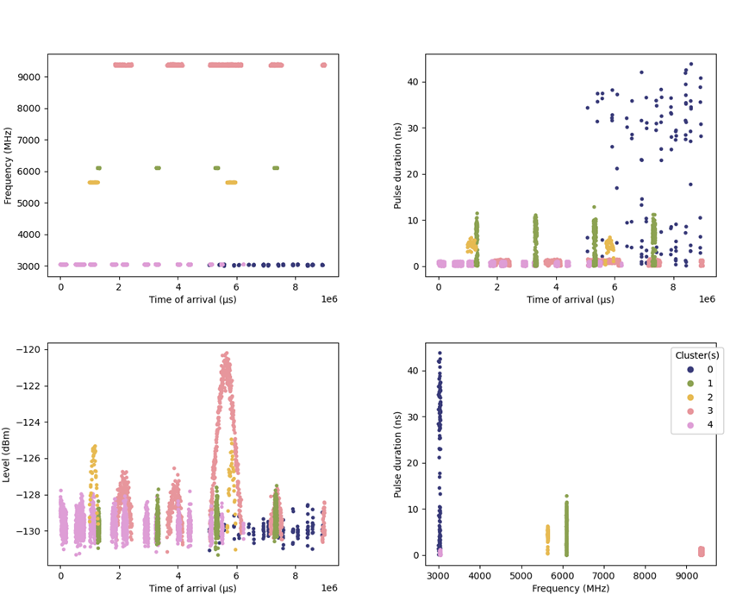
Application case 2
Vérité terrain

Slide 24
Thank you for your attention

