Slide 1
GME team meeting
Manon MOTTIER
02/12/2020

Slide 2

Contextualisation
The PhD student
Manon MOTTIER
Thesis CIFRE
2nd year
The thesis
Artificial intelligence for passive radar
Introduction of artificial intelligence in the field of radar intelligence in order to improve the separation, characterization and identification of radars through new approaches in the exploitation and processing of radar electromagnetic signals
Management
Thesis director: Frédéric PASCAL
co-supervisor : Gilles CHARDON

Slide 3
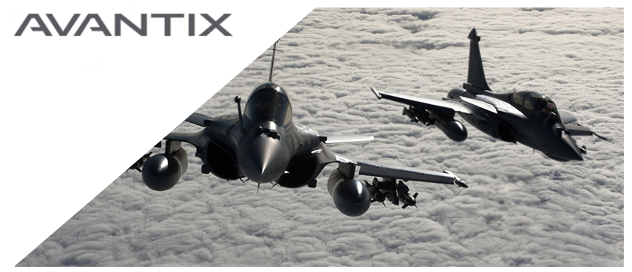
Contextualisation
The company
AVANTIX (ATOS Group)
French company that designs critical high-tech systems for strategic industry sectors worldwide
Provides homeland protection and military forces with the capability to control the electromagnetic spectrum, including weak and short duration signals for electronic warfare
Their goal : delivers advanced knowledge of threats and superior tactical situation awareness

Slide 4
Works
Main challenges
Deal with simulated data : acquisition of real data is difficult because they are classified
Determining the number of transmitters present in a signal
    Clustering impulsions : Classify each pulse of this signal
    Comparison of clusters : cluster grouping to identify the total number of transmitters present in the signal
Identify the types of transmitters

Slide 5
Works
Issues
Implementation of a 2-step strategy for deinterlacing a signal
    Hdbscan Clustering
    Hierarchical Agglomerative Clustering combined with Optimal Transport
Writing a methodological paper submitted to a specialized conference

Slide 6
Thank you for your attention

Slide 7
Annexes

Slide 8
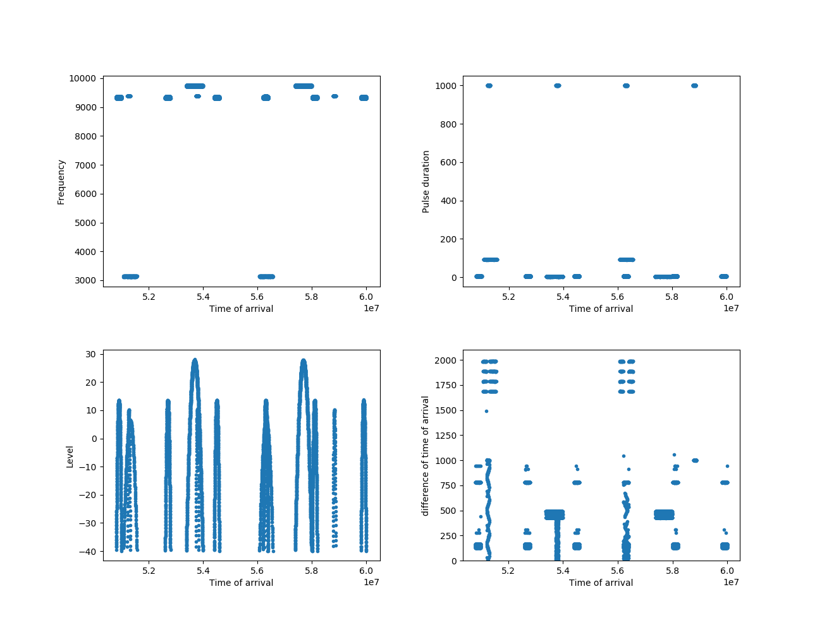
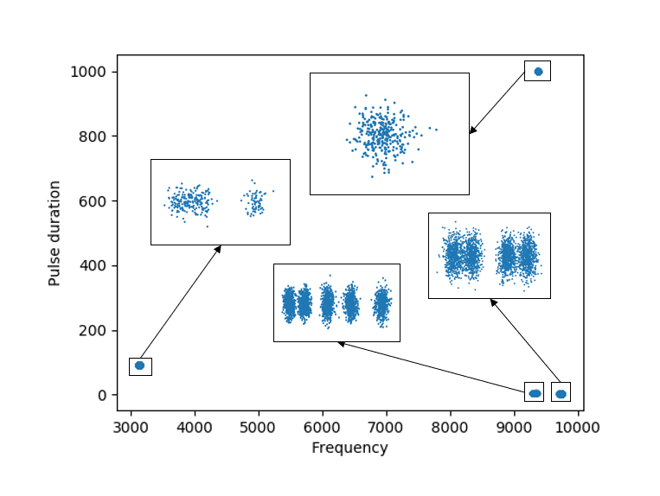
Example

Slide 9
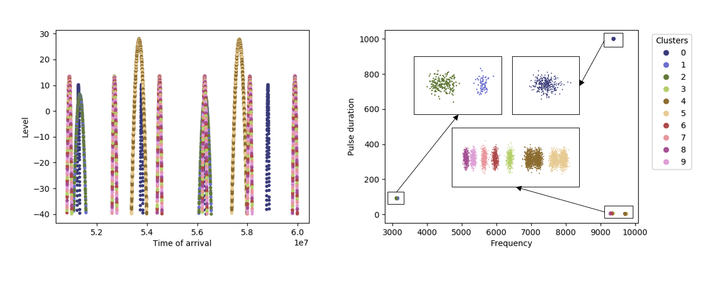
Example

Slide 10
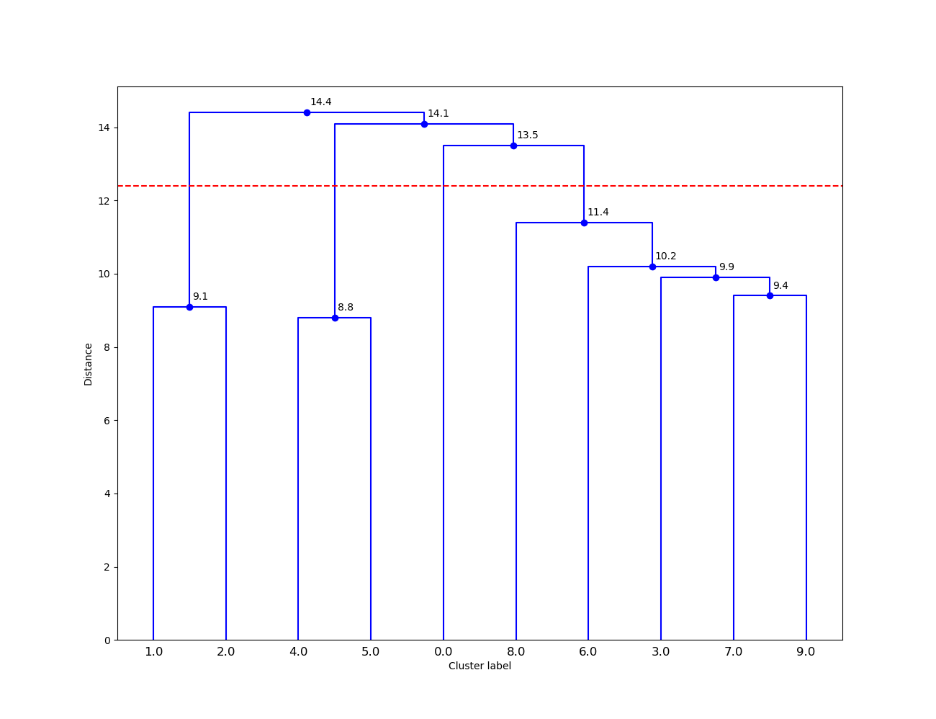
Example

Slide 11
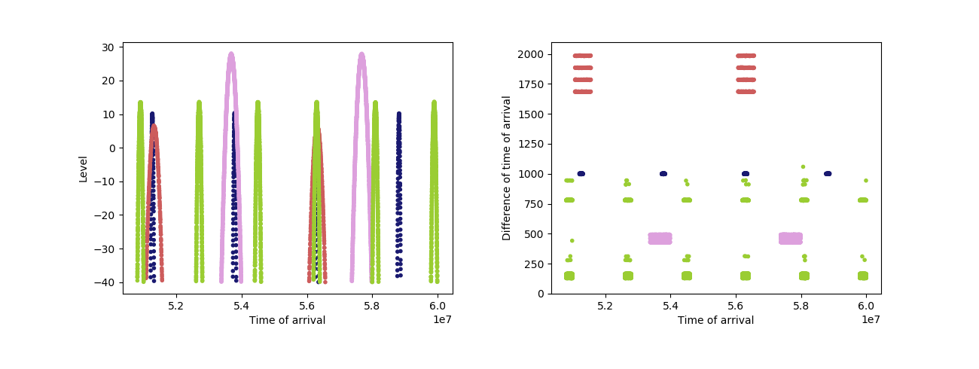
Example

