Slide 1
GPI team meeting
Manon MOTTIER
17/06/2021

Slide 2


Contextualisation
The PhD student
Manon MOTTIER
Thesis CIFRE, 2nd year
The thesis
Use and development of machine learning tools in the field of Electronic Warfare specifically for passive RADAR intelligence
RADAR signals deinterlacing includes techniques capable of:
    Separating
    Characterizing
    Identifying all transmitters present in the signal
Management
Thesis director: Frédéric PASCAL
co-supervisor : Gilles CHARDON

Slide 3
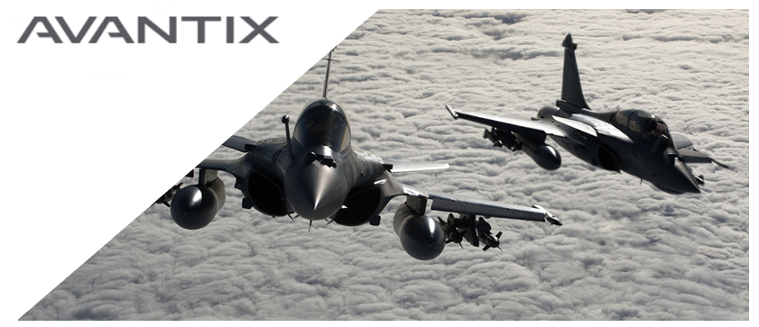
Contextualisation
The company
AVANTIX (ATOS Group)
French company that designs critical high-tech systems for strategic industry sectors worldwide
Provides homeland protection and military forces with the capability to control the electromagnetic spectrum, including weak and short duration signals for electronic warfare
Their goal : delivers advanced knowledge of threats and superior tactical situation awareness

Slide 4
Proposed approach
Data description:
Realistic simulator since real labeled data are not easily accessible
Each dataset is composed of RADAR pulses, described by only 4 features:
      Frequency (F),
      Pulse Width (PW)
      Level (L)
      Time of Arrival (TOA)
Unsupervised setting but evaluate methods on labeled datasets

Slide 5
Proposed approach
Methodology: Implementing a two-step strategy for signal deinterlacing
Step 1: Clustering
Step 2: Cluster fusion
Cluster each observation of this signal on two features: Frequency and Pulse Width
Development of a hierarchical clustering algorithm using optimal transport distances
Construction of a decision model using several unsupervised metrics to cut the dendrogram and stop cluster fusion

Slide 6
Application case

Slide 7
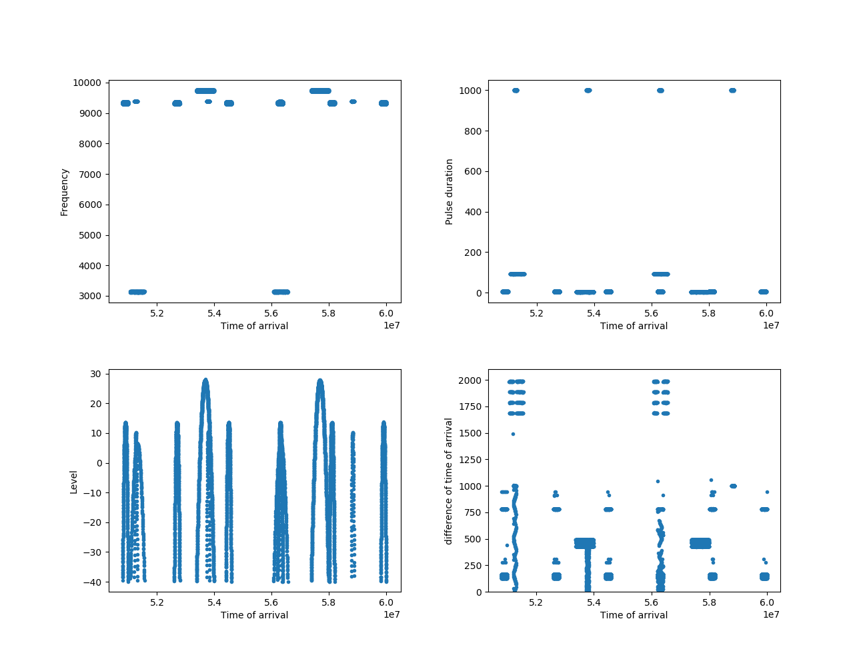
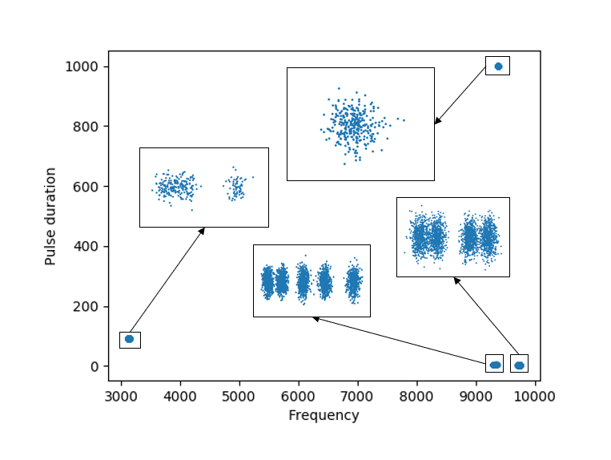
Application case

Slide 8
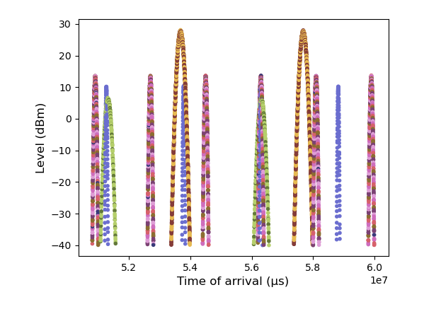
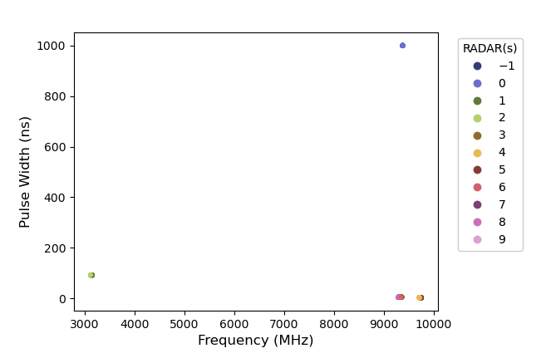
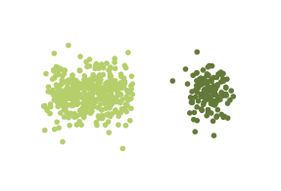
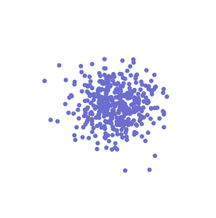
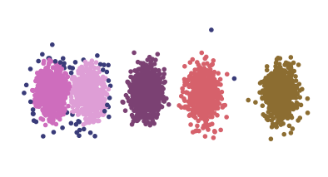
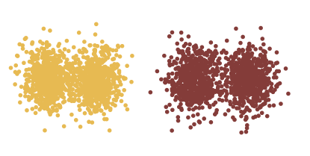
Application case
Step 1: Clustering with HDBSCAN
CLUSTER | Pulses | %
-1 | 954 | 0,6%
0 | 8 199 | 5,3%
1 | 2 703 | 1,8%
2 | 8 094 | 5,3%
3 | 13 907 | 9%
4 | 32 704 | 21,2%
5 | 32 726 | 21,3%
6 | 13 892 | 9%
7 | 13 891 | 9%
8 | 13 502 | 8,8%
9 | 13 368 | 8,7%

Slide 9
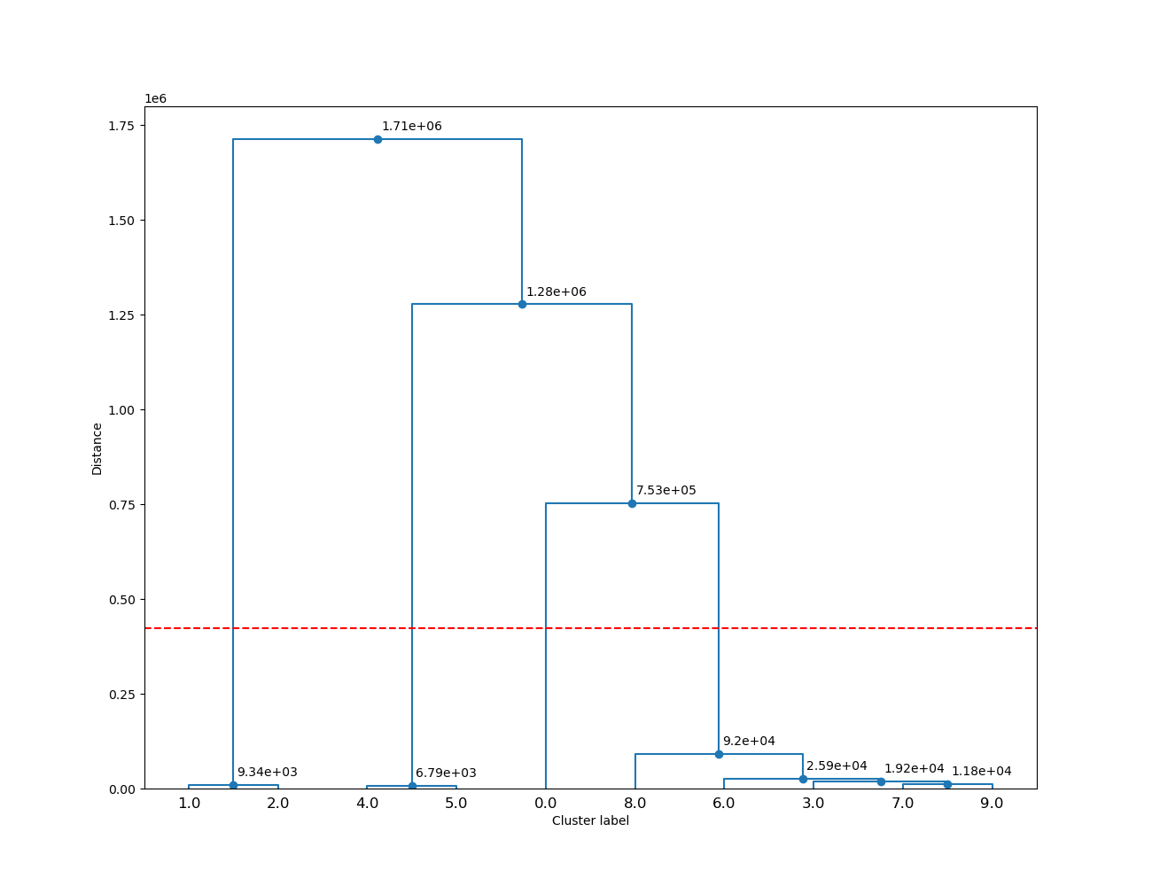
Application case
Step 2: Cluster fusion
Best cut = 4 groups

Slide 10
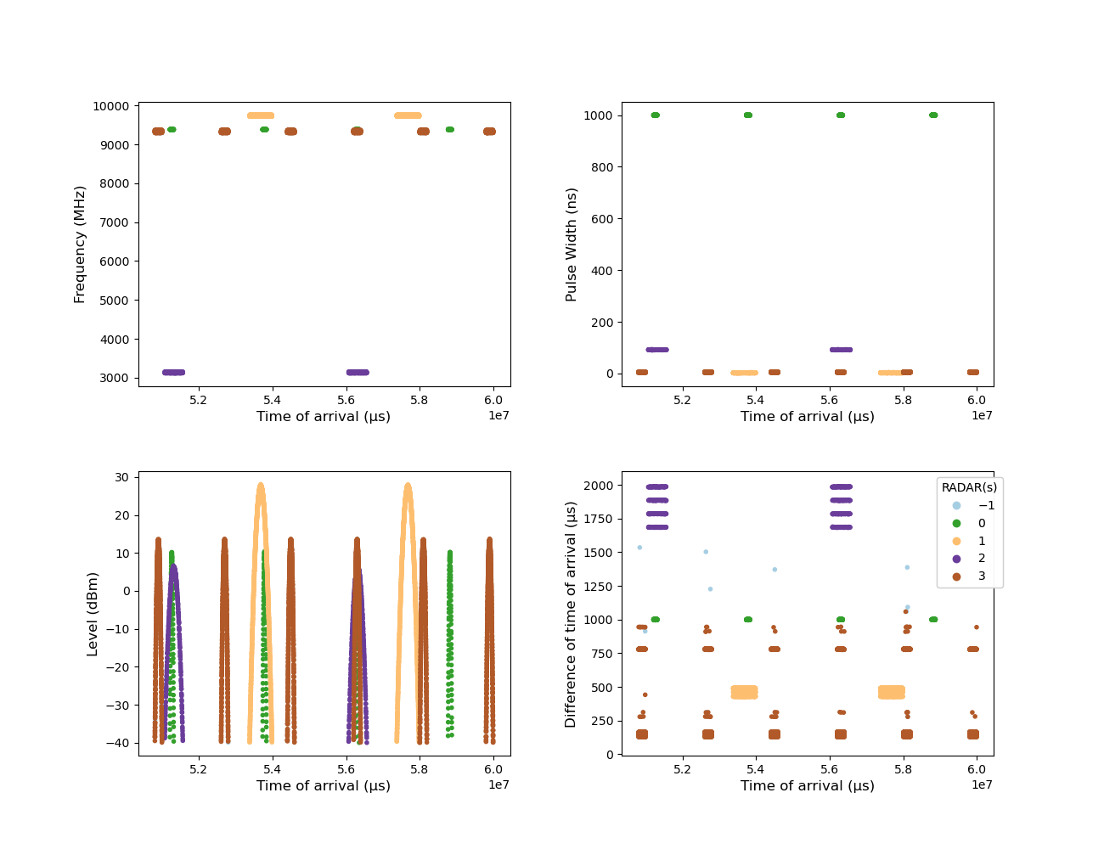
Application case
Final grouping
Statistics | Value
Homogeneity | 1
Completeness | 1
Unclassified rate | 0,6%

Slide 11
Thank you for your attention

