Slide 1
Deinterleaving RADAR pulses
Réunion d’équipe
07/07/2021
Manon Mottier

Slide 2


Context
Thesis CIFRE:
Student: Manon MOTTIER (2nd year)
Avantix: Jean-Daniel BUSI
CentraleSupélec: Frédéric PASCAL & Gilles CHARDON
The subject:
Use and development of machine learning tools in the field of Electronic Warfare specifically for passive RADAR intelligence
Improvement of RADAR signal processing thanks to ML approaches
RADAR signals deinterlacing includes techniques capable of:
  Separating
  Characterizing
  Identifying all transmitters present in the signal

Slide 3
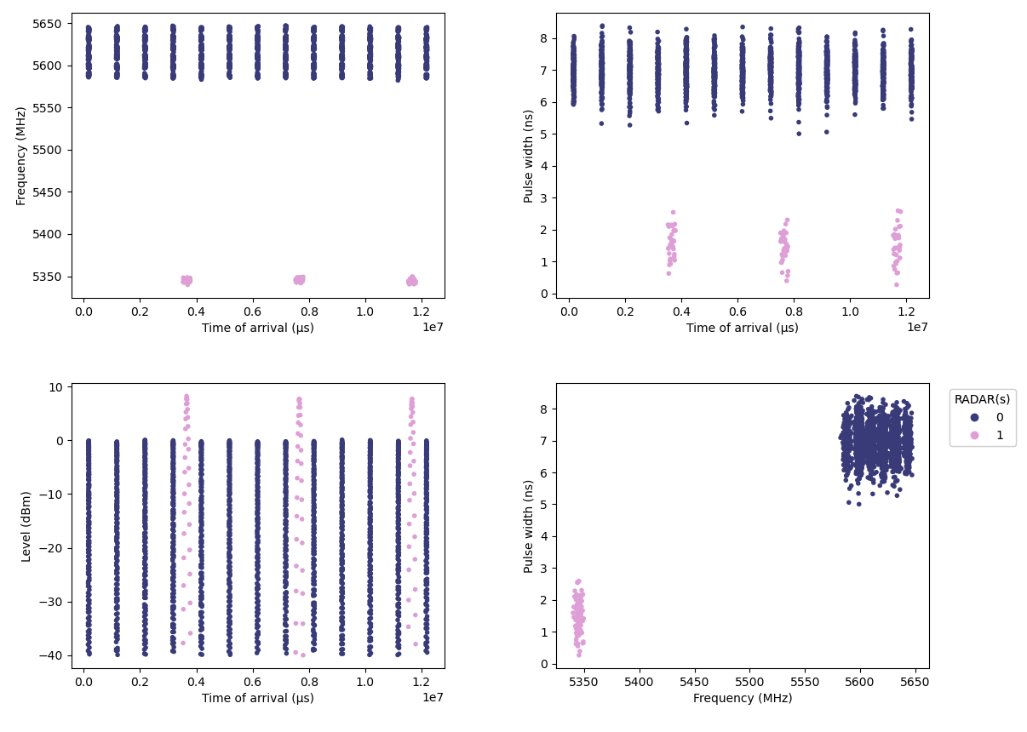
Proposed approach
Data description
Example of a simple signal containing 2 RADARs
Work only from these 4 features (Frequency, Pulse Width, Level, Time of Arrival)
No use the dTOA
No assumption on the waveform
Unsupervised setting but evaluate methods on labeled datasets

Slide 4
Proposed approach
Methodology
Methodology: Implementing a two-step strategy for signal deinterlacing
Step 1: Clustering
Step 2: Cluster fusion
Cluster each observation of this signal under the constraint of not merging different radars in one cluster
Hierarchical agglomerative clustering combined with optimal transport distance

Slide 5
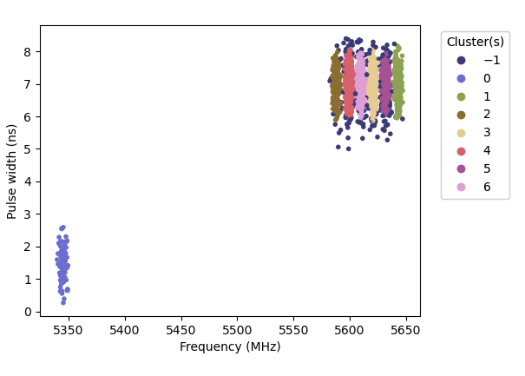
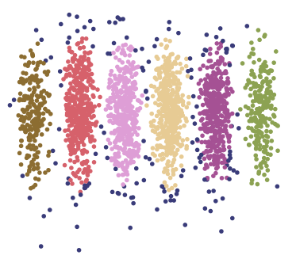
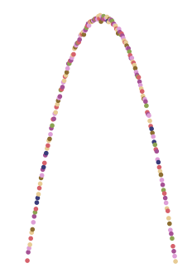
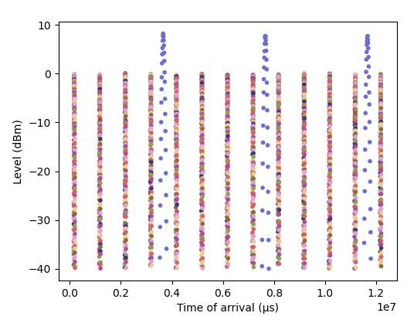
Proposed approach
Step 1: Clustering
Step 1: Clustering with HDBSCAN
Application of clustering algorithm on two features: Frequency and Pulse Width
Unsupervised algorithm that allows us to search for clusters of varying densities
Few parameters to optimize

Slide 6
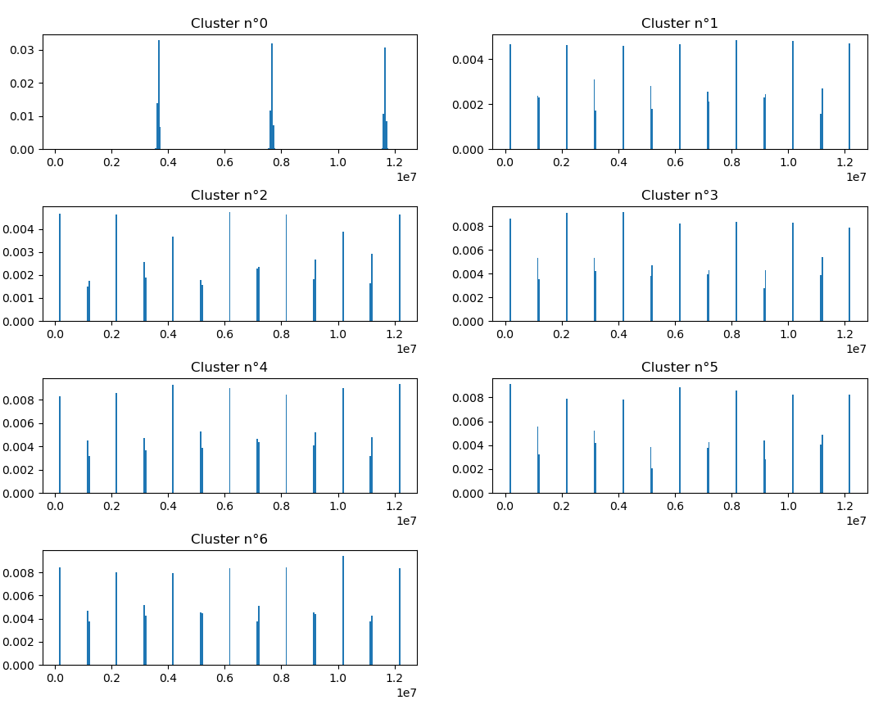
Proposed approach
Step 2: Cluster fusion
Development of a hierarchical clustering1 algorithm using optimal transport distances:
Dimensionality reduction: each cluster is represented by a histogram of its TOA
Compute distances between cluster histograms using optimal transport
Aggregation of the 2 closest clusters i.e., the 2 clusters with the lowest transport costs
Computation of new costs between old clusters and the new ones
Repeat steps 2 to 4 until a single cluster is obtained
High cost
Low cost

Slide 7
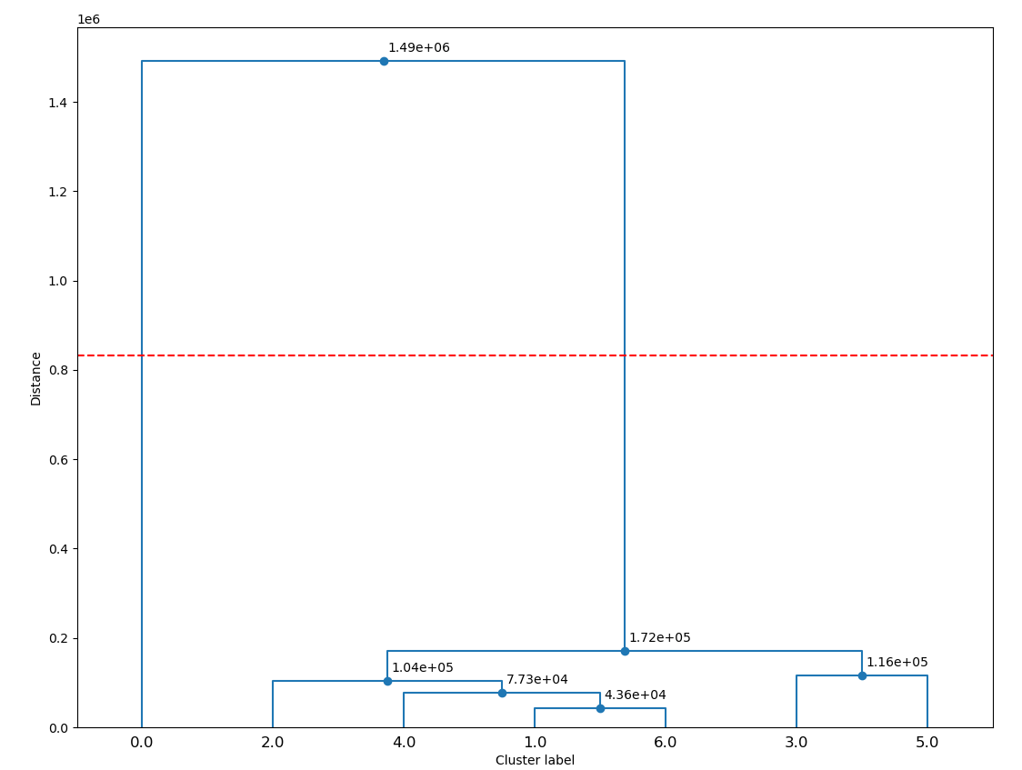
Proposed approach
Step 2: Cluster fusion
Construction of a decision model using several unsupervised metrics to cut the dendrogram and stop cluster fusion:
Silhouette score
Calinski-Harabasz score
Davies-Bouldin score
    Apply Majority rule
Best cut

Slide 8
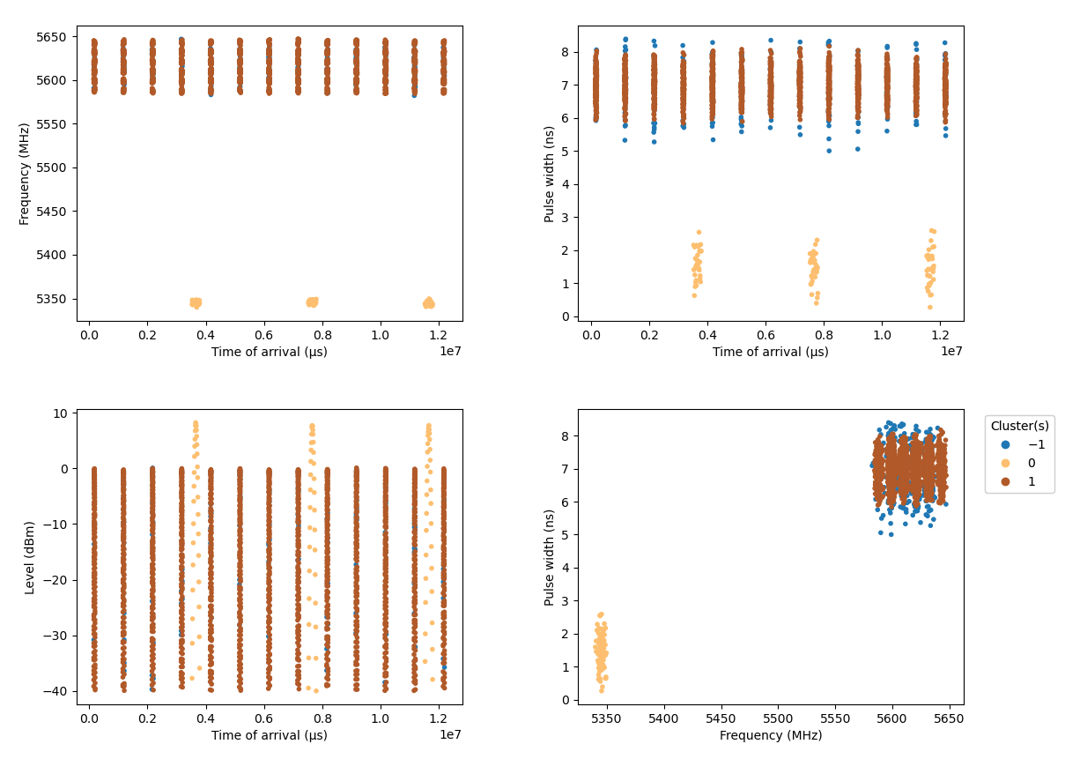
Proposed approach
Step 2: Cluster fusion
Final groupings
Statistics | Value
Homogeneity | 1
Completeness | 1
Unclassified rate | 6,3%
Notes:
Homogénéité : mélange
Completeness : dispersion

Slide 9
Conclusions and Next objectives
Works on moderately complex cases
Publication of a research article: “Deinterleaving and Clustering unknown RADAR pulses” - Manon Mottier; Gilles Chardon; Frédéric Pascal
Next objectives
  Clustering: Define a metric to identify identical RADARs in Frequency and Pulse Width
  Improve model decision to cut the dendrogram:
    Create a new metric
    Use alternative methods (LSTM)
  Classification and RADAR identification from a reference database

Slide 10
Thank you
For more information please contact:
Manon MOTTIER
manon.mottier@atos.net

