Slide 1
State machine generator

Slide 2
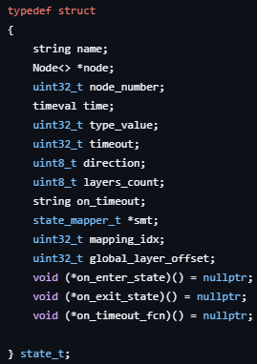
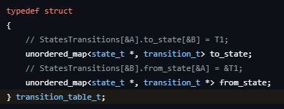
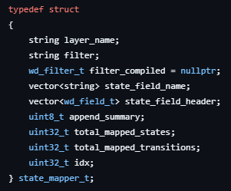
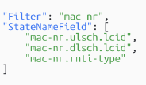
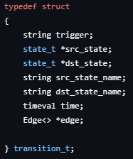
State Machine Generator Architecture Overview
: cpp file
: hpp file
Direction ^ layer_name ^ state_field_name.value()
Machine
TX / RX
Number of layers in this packet
String current_state
vector<state_mapper_t> StateMap
unordered_map<string, state_t> StatesNodes
unordered_map<state_t *, transition_table_t> StatesTransitions
state_t *PreviousStateNode
state_t *CurrentStateNode
transition_t * CurrentTransition
transition_t * PreviousTransition
wd_t* wd
Pointer to corresponding state mapper
State_t name Must be unique
Layer_name comes from smt
State_field_name comes from smt
Each state has its transition table

Slide 3
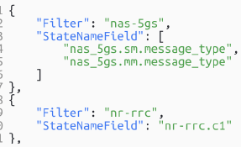

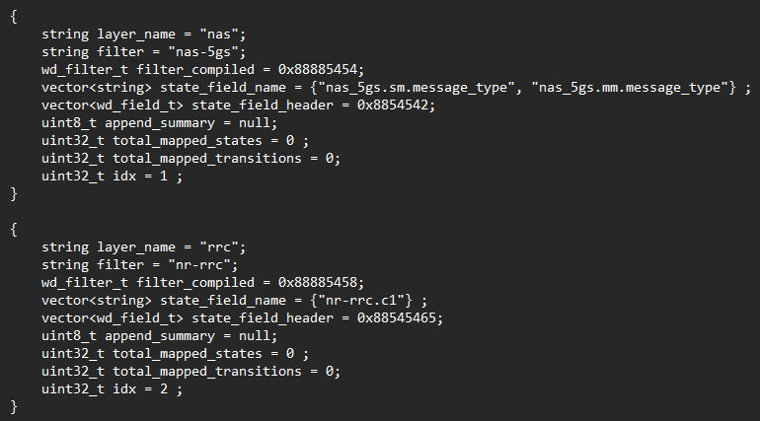
State Machine Generator Architecture Overview
: cpp file
config.json
input.pcap
: hpp file
WDMapper
Machine
1
StateMachine.init(config.json)
String current_state
vector<state_mapper_t> StateMap
unordered_map<string, state_t> StatesNodes
unordered_map<state_t *, transition_table_t> StatesTransitions
state_t *PreviousStateNode
state_t *CurrentStateNode
transition_t * CurrentTransition
transition_t * PreviousTransition
wd_t* wd
init()
creates StateMachine memory elements
initialize dissector : wd_init(default_proto_name)
ResetModel() : classical reset + ResetLoopDetector
InitStateMapper() : iterates on rules defined in config.json (state_mapper.mapping.setup); compile the filter; populates StateMap
InitExcludes
EventLoopSetup
Memory Layout at init stage

Slide 4
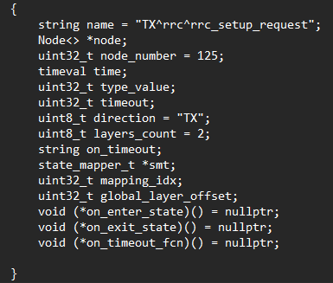
State Machine Generator Architecture Overview
: cpp file
config.json
input.pcap
: hpp file
WDMapper
wdissector
Machine
1
StateMachine.init(config.json)
wd_init() : init wireshark instance and launch multi dissector threads
String current_state
vector<state_mapper_t> StateMap
unordered_map<string, state_t> StatesNodes
unordered_map<state_t *, transition_table_t> StatesTransitions
state_t *PreviousStateNode
state_t *CurrentStateNode
transition_t * CurrentTransition
transition_t * PreviousTransition
wd_t* wd
2
wd_set_dissection_mode
3
ConfigurePseudoHeader(StateMachine)
4
For loop to load models ie pcap files :
StateMachine.LoadModel
StateNodes
LoadModel() :
Open pcap reader
Extract number of packets
iterates over raw packets :
  PrepareStateMapper : register filters from StateMap to wd
  dissect the current packet
  RunStateMapper(true, true, true)
RunStateMapper() :
iterates over StateMap :
  check filter compiled
  iterates over filters :
    If able to extract field from packet using the filter
      state_name = TX ^ layer_name ^field value (extracted by filter from current packet)
      if state_name not in StateNodes : AddState
      Transition()
Memory Layout at first packet parsed

Slide 5
State Machine Generator Architecture Overview
: cpp file
config.json
input.pcap
: hpp file
WDMapper
wdissector
Machine
1
StateMachine.init(config.json)
wd_init() : init wireshark instance and launch multi dissector threads
String current_state
vector<state_mapper_t> StateMap
unordered_map<string, state_t> StatesNodes
unordered_map<state_t *, transition_table_t> StatesTransitions
state_t *PreviousStateNode
state_t *CurrentStateNode
transition_t * CurrentTransition
transition_t * PreviousTransition
wd_t* wd
2
wd_set_dissection_mode
3
ConfigurePseudoHeader(StateMachine)
4
For loop to load models ie pcap files :
StateMachine.LoadModel
LoadModel() :
Open pcap reader
Extract number of packets
iterates over raw packets :
  PrepareStateMapper : register filters from StateMap to wd
  dissect the current packet
  RunStateMapper(true, true, true)
RunStateMapper() :
iterates over StateMap :
  check filter compiled
  iterates over filters :
    If able to extract field from packet using the filter
      state_name = TX ^ layer_name ^field value (extracted by filter from current packet)
      if state_name not in StateNodes : AddState
      Transition()
AddState() :
computes all data for the state
add the state to StateNodes
Transition() :
(dst_state = StateNodes.find(new_state)) and CurrentState != null

