Slide 1
UE
gnode
RAR
RRCSetupRequest
Ue identity, establishment cause
RRCSetup
RadioBearerConfig
RLC : data
RLC : data
RLC : data
RLC : control
RRCSetupComplete : [NAS registration request]
Registration request, it will be conveyed to the AMF selected by the gNode
NAS Identity Request
Ask for UE’s SUCI
NAS Identity Response
SUCI
NAS Auth Request
AUSF selection
NAS Key Set Identifier : 0000, ABBA : 0000, (AUTN : SQN xor AK != 0, AFM : 8000, MAC : =!0)
NAS Auth Request
NAS Auth Response
Response to the auth challenge
Security Mode command
Type of ciphering algo : 5G-EA0 (null), IMEISV request

Slide 2
UE
gnode
Security mode complete & registration request (in NAS message container)
UE signifies the completion of the NAS security procedure & registration type (initial), UE capabilities, potential GUTI
RRC : security mode command
Commands activation of AS security : indicates ciphering algo nea0(null) and integrityalgo nia2
RRC : security mode complete
Activation completed : ciphering will be enable after this message
RRCReconfiguration & NAS Registration accept
Only sent if authentication and security processes have been completed
Registration process is successful : provide the new GUTI to the device
RRCReconfigurationComplete
RRCConnectionReconfiguration completed
NAS Registration complete

Slide 3
Observations generates these questions/suppositions :
RRCSetupComplete : can’t be skipped, it could be the wireshark filters that are wrong and don’t provide a correct observation of the packets
Registration Request : is sent later by the UE, it’s not the order indicated in the documents but it seems to be optional in the RRCSetupComplete. Documents indicate that the RegistrationRequest indicate information for the device to register itself in the network.
The Nas Authentication Response message is missing. Security mode commands at both RRC level and NAS level indicate no ciphering to secure the data and its acknowledged by the UE. Question : does the NAS authentication request inlcudes parameters that do not require a response regarding the following of the exchanges. It seems that the Authentication request sent to the UE is correctly formatted and that it should answer to it.
Conclusion :
  Apparently, the phone is not answering to Authentication Request. And that does not the rest of the exchanges to happen.
  The security Mode commands and the registration accept seems to indicates that everything works correctly.
  Assumptions : either we do NOT see the Nas Authentication response in wireshark, either the device is not sending it and the core network is modified to do everything as it should work.
Authentication process full description : 5G NAS Authentication and Security Procedure Explained: Step-by-Step Message Flow

Slide 4
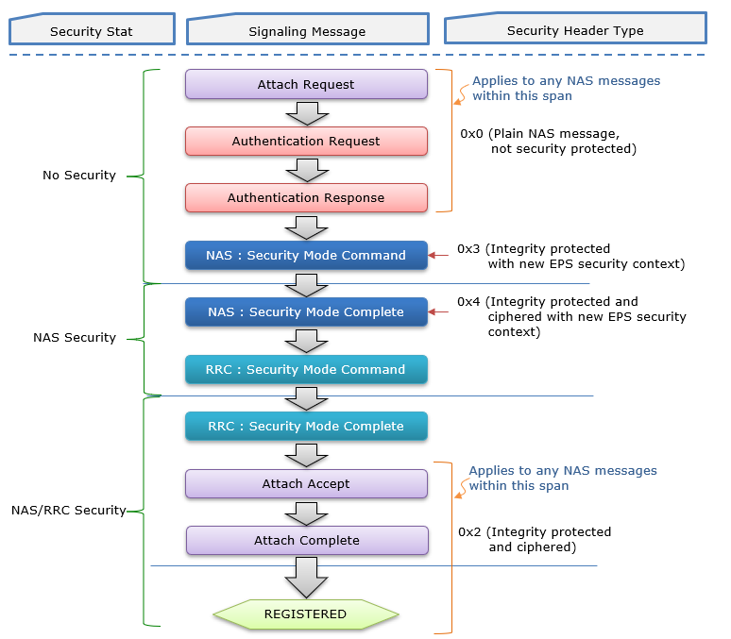

Slide 5
UE
gnode
RAR
RRCSetupRequest
Ue identity, establishment cause
RRCSetup
RadioBearerConfig
RLC : data
RLC : data
RLC : data
RLC : control
RRCSetupComplete : [NAS registration request]
Registration request, it will be conveyed to the AMF selected by the gNode
NAS Identity Request
Ask for UE’s SUCI
NAS Identity Response
SUCI
NAS Auth Request
AUSF selection
NAS Key Set Identifier : 0000, ABBA : 0000, (AUTN : SQN xor AK != 0, AFM : 8000, MAC : =!0)
NAS Auth Request
NAS Auth Response
Response to the auth challenge
Security Mode command
Type of ciphering algo : 5G-EA0 (null), IMEISV request

