Slide 1


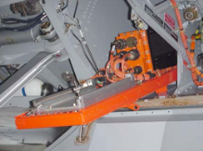
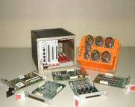
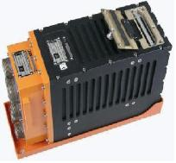
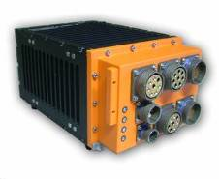
FLIGHT TEST INSTRUMENTATION
DIANE
Spy all data or parse in real-time
Embedded storage
Data recording: digital, analog
Software for:
  setup,
  data conditioning,
  data processing,
  data counting
  maintenance.
Platform for recording, telemetry, output IENA.
At the heart of embedded telemetry installation
Data concentrator for collection, processing and formatting for telemeter or recorder
Embedded on | RAFALE, MIRAGE, ATL2, FALCON, NEURON
Several kind of IO | 1553B, 3910, DGBS,A429, CCE,CAN,PCM, LS, ethernet, various sensors, audio/video.

Slide 2
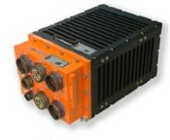
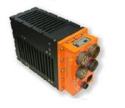
FLIGHT TEST INSTRUMENTATION
DIANE
Digibuses | Channels | Comments
Digibus | 2 | GAMT101
1553B | 4 | MIL STD 1553 B
3910 | 1 | STANAG 3910
Serial links | 8 | RS232 / RS422
PCM | N/A | Telemetry
CCE | 3
ARINC | 16 | 429
Manchester | 4 | M88-BTM-IPS-UMP33
CAN | 4 | SAEJ 1939
TOR/ frequency | N/A | Isolated inputs
 | 8 slots version (9.5 dm3) | 5 slots version (7.5 dm3)
Size (L*H*P) | 202 x 152 x 314 mm | 124 x 194 x 314 mm
Weight | < 10Kg | < 6Kg
Time frame | 10µs | 10µs

