Slide 1
Air Land Sea electronics
Cybersecure embedded and ruggedized critical systems

Slide 2
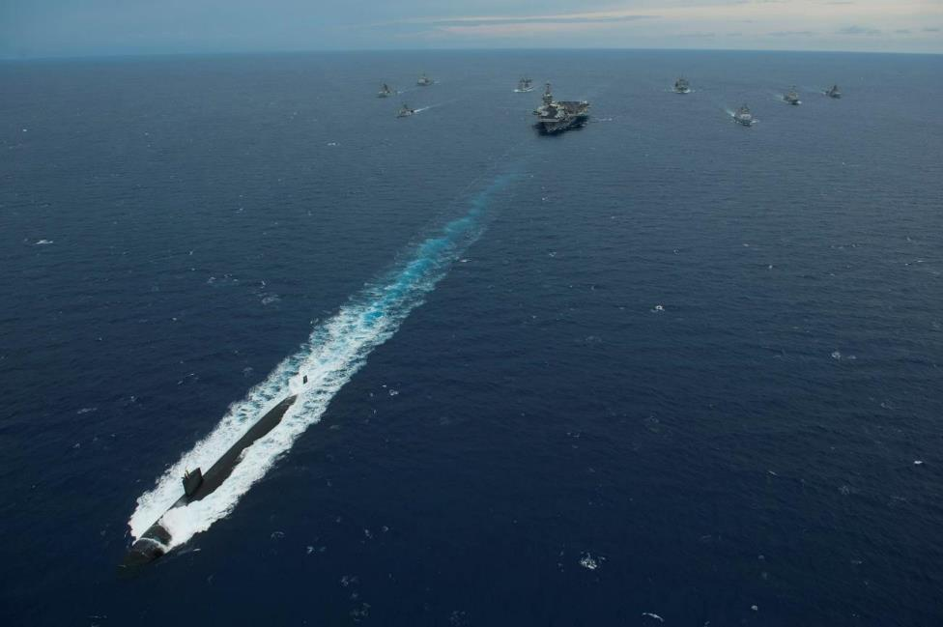

Identity
  Est. 1962, heir of Bianchetti Electronique Navigation (1879)
  Design and manufacture of navigation and safety instruments
  Strong domestic and international position
  Brand of Atos Group

Slide 3

Worldwide customer deployments
At Atos, we do more than accompany our clients on their digital journey, we actively help them to stay one step ahead
~40
countries
>50
disributors
1962
established

Slide 4








Targeted Markets
Military surface vessels
Military submarines
Commercial vessels
High valuable cargo ships
High speed passengers vessels
Fishing vessels
Mega-yachts, yachts and recreational ships
4
Notes:
4

Slide 5
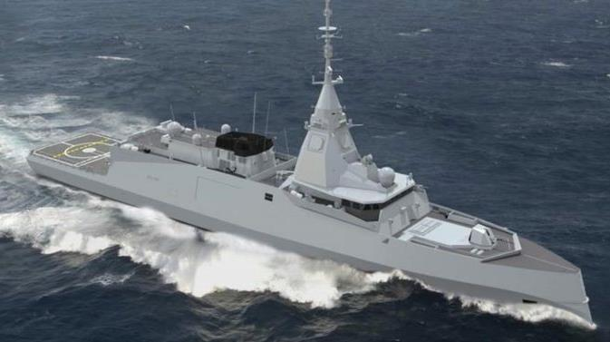
Shore link system
NDDU/CynApps
Navigation systems
Flowmeters
Firing missile systems
Multifunction
Repeaters
EM speed log

Slide 6


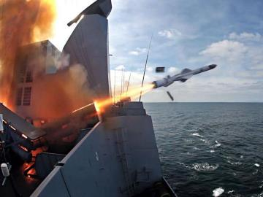
Firing range facilities and missile systems
The core business of industrial defence
Exocet
ASTER
MICA
SCALP
CROTALE
Flare
CONFIDENTIAL

Slide 7
Thank you
For more information please contact:
T+ 33 1 98765432
M+ 33 6 44445678 firstname.lastname@atos.net

