Slide 1
RECYLAM (EN version)
REchargement de CYlindre de LAMinage
Surfacing of Rolling Mills

Slide 2
Aim of the meeting
Introduction of the partners
Discussions about the project’s content
Finances assessment
Determination of the timeline and main deadlines for administrative work.

Slide 3
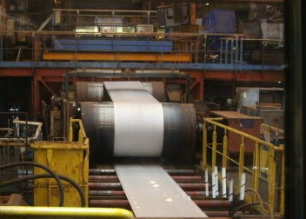
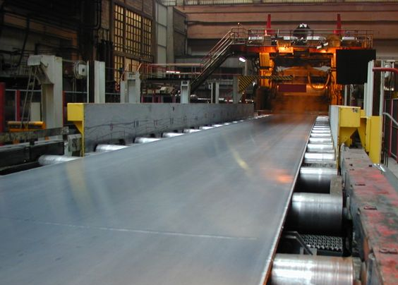
Project presentation
Surfacing of Rolling Mills
Markets :
  Steelmaking and alloys forming
  Tooling
  Additive manufacturing – welding - wiredrawing
Applications :
  Rolling mills for cold forming (and hot forming)
Aims and context:
  Identify an alternative process for manufacturing rolling mills.
  Develop a cost effective and compliant surfacing process.
  Replace Chromium coating on cold rolling mills (REACH compliance)
Innovations
New surfacing processes for rolling mills manufacturing. Improvement of mechanical properties and REACH compliance Surfacing with high mechanical strength materials (development of new grades) POC of rolling mills
Challenges
Reaching high deposition rates for surfacing large amount of material. Surfacing with very hard materials (thermal induced cracking) Promoting homogenous mechanical properties over the entire active surface of the coated mill.

Slide 4
Présentation du projet
Rechargement de cylindre de laminage
Objectifs / Enjeux :
  Trouver une alternative aux procédés actuels de fabrication des cylindres
  Développer un procédé de rechargement économiquement viable et conforme au CDC
  Supprimer le revêtement chrome dur appliqué au cylindre de laminage à froid (REACH)
Marchés :
  Sidérurgie et métallurgie
  Outillage
  Fabrication additive/ soudage/tréfileur
Applications :
  Rouleaux de laminage à froid (et à chaud)
Innovations du projet
Rechargement pour la production et la réparation de cylindre de laminage Amélioration des propriétés du revêtement et compatibilité REACH Dépose de matériaux à haute résistance mécanique (identification ou développement de nouvelles nuances) Prototypage et essais sur laminoir.
Verrous à lever
Atteindre des taux de dépose permettant de déposer des très grandes quantités de matière. Déposer des matériaux très dur (risques de fissuration). Homogénéiser les propriétés mécaniques du dépôt sur la portée du cylindre.

Slide 5
Study proposal
Surfacing of Rolling Mills
1st STEP:
  Pre-study: (cofunded by IRT M2P at 45%) 8 month duration with a GO-NOGO by December.
  Aim: Asses the feasibility from the materials aspect (maximum hardness, crack management, etc…), testing of promising processes and cost assessment.
  Application: Manufacturing of small size surfaced cylinder to carry out mechanical and metallurgical analysis.
  GO-NOGO: end of 2022 for launching large scale project in 2023 (2nd STEP)
2nd STEP:
  Research project cofunded by IRT M2P at 45% (55% funded by industrials), large consortium, 3 to 5 years duration.
  Aims: Identification of the best fitted process, Prove of concept, Manufacturing of industrial scaled mills prior industrialization.

Slide 6
Proposition d’études
Rechargement de cylindre de laminage
1st STEP:
  Pré-étude: (étude de faisabilité financée à 45% par M2P) 8 mois qui doit finir en Décembre 2022
  Objectif: valider la faisabilité du point de vue matériaux et identifier les procédés pertinents et étude de coût.
  Mise en œuvre: réalisation de rechargement sur des cylindres de petites dimensions et tests mécaniques et métallurgiques.
  GO-NOGO: fin 2022 pour lancement d’un projet dédié en 2023 (2nd STEP)
2nd STEP:
  Projet propre financé à 45% par l’IRT M2P, multipartenaire, durée de 3 à 5 ans.
  Objectifs: Identifier le procédé le plus adapté, réaliser et tester des prototypes, fabriquer un démonstrateur et monter en TRL pour l’industrialisation.

Slide 7
Project structuration
Surfacing of Rolling mills
List of the tasks:
  Task 0: Project management (ANR submission project proposal, funding and financial management, stocks and supply…)
  1st Task: State of the art of the surfacing processes and materials → selection of materials for testing (up to 4 materials)
  2nd Task: Manufacturing of cylindrical specimens surfaced with different processes (up to 3 different processes)
  3rd Task: Metallurgical and mechanical analysis of the test specimens
  4th Task (optional): structuration of the future research project.
Macro planning and main milestones:
December 2022:
Estimation of project finances
Writing of the ANR project proposal and submission for approval of IRT M2P fundings.
T1: State of the art (3 mths)
End of June: materials selection for WAAM and WLAM processes
Project structuration: consortium, specifications, writing of the ANR project proposal, fundings, etc…
T2: Powder cladding processing of specimen
T2: WAAM and WLAM depositions on specimens
T3: characterisation of the surfaced layers (6 mths)
March 2023: GO-NOGO Project structuration
T0 start of the 1st step ~May

Slide 8
Process developpers
Surfacing of Rolling mills
Field of expertise:
  Surfacing technologies:
    IREPA LASER (powder/wire laser additive manufacturing, Alsace FRANCE)
    INSTITUT DE SOUDURE (wire arc/laser additive manufacturing, Moselle FRANCE)
    FRONIUS (wire arc additive manufacturing Paris FRANCE)
    INSTITUT MAUPERTUIS (Powder/wire, arc/laser additive manufacturing, Bretagne FRANCE)
    VOESTALPINE BOHLER (wire/strips arc/electroslad welding, BELGIUM)
    TECHNOGENIA (powder laser additive manufacturing, FRANCE)
  Materials supply:
    VOESTALPINE BOHLER
    SELECTARC
    WELDING ALLOYS

Slide 9
Specification from end users
Surfacing of Rolling mills
Similar specifications between ARCELORMITTAL – CONSTELLIUM – APERAM
Rolling mills with diameter of [400-600]mm diameter and 1 to 2.3m length :
Deposition rate compliant to industrial standards
Effective cost of the mill bellow 20k€
Coating layer depth of 30 to 50mm.
No crack
Hardness between 800 and 900 HV30 post-process (surfacing + post-treatments)
Surface roughness compatible with precision machining : Ra between 0.4 and 2.3µm
Homogeneous mechanical properties throughout the surface layer and over the length
Porosity below 0.5%
No stamping of the rolled materials
Resistance to local heat overshoot at 200°C and peaks at 850°C.
Substrate torque mechanical properties → ideally reusing former cylinders.

Slide 10
Éléments de cahier des charges
Rechargement de cylindre de laminage
Cahier des charges similaire ARCELROMITTAL – CONSTELLIUM – APERAM
Pour des cylindres de 400 à 600mm de diamètre et 1 à 2,3m de largeur de portée :
Temps de dépôt compatible avec les cadences industrielles
Coût de fabrication du rouleau <20k€
Épaisseur de rechargement: 30 à 50mm sur toute la portée, contrainte de hertz étendue sous la surface (max à 7mm)
Absence de fissure
Dureté: 800 à 900 HV30 en fin de process (dépôt + éventuel post-traitement)
Surface rectifiable, Ra de 0,4 à 2,3µm
Homogénéité de la résistance mécanique, de la résistance à l’usure et résistance à l’indentation.
Moins de 0,5% de porosité (CONSTELLIUM),
Absence de marque sur la matière laminée.
Resistance à des surchauffes locales de 200°C et aux incidents ponctuels en pointe à 850°C
Matériau du substrat → propriété mécanique en torsion → idéalement réutiliser les cylindres existants.

Slide 11
Studied processes
Process types | Wire - Arc | Wire - Laser | Powder - Laser
Maximum deposition rate | Up to 15kg/h (with FRONIUS Twin) | 8kg/h depending on the deposition technology | 12kg/h with laser cladding (TECHNOGENIA)
Deposition equipment cost | 45k€ | 400k€ | 350k€
Substrate dissolution | Significant | Low | Low
Porosity | high | Low | Low
Spatial resolution | 2 – 6mm | 2mm | fittable
Additive materials | Specific wires (limitation with cored wires) | All type of wires | Powder <20µm
Subcontractors | IS, IM, VOESTALPINE BOHLER, FRONIUS | IS, IM, IREPA LASER | TECHNOGENIA

Slide 12
Materials
Examples of materials to test:
  High speed steel
  Chromium enriched cast iron
  Cored wires
  W carbides powders for laser cladding
  …
Suppliers:
  Wires: VOESTALIPNE BOHLER, SELECTARC, WELDING ALLOYS
  Powders: TECHNOGENIA, IRT M2P, GKN, HOGANAS, SANDVIK, OERLIKON…

Slide 13
RECYLAM Step 1
Sufacing of rolling mills
Budget : 76 – 114 k€ (45%PIA)
  Duration : 8 mois
  Starting from 01/05/22
Partners :
12 - 23 k€ for administrative work (submission to ANR, reporting, financial regulation, …)
10 k€ for project management
5 - 10 k€ for materials supply (substrate, powders and wires)
25 – 36 k€ for manufacturing the specimen and collecting process parameters
9 – 20 k€ for analysis of the surfaced specimen
15 k€ for the structuration of the research project (optional: GO-NOGO) → if NOGO: more analysis
Financial contributions | k€
ARCELORMITTAL | 10
CONSTELLIUM | 10
APERAM | 10
TECHNOGENIA | 10
RMS | 10
IS | 10
IRT M2P | 54
Sum of contributions | 114

Slide 14
What is next?
Letter of intent
NDA
Submission of the project to ANR
Contracting partnership
Kick-off meeting

Slide 15
Pour plus d’informations :
contact@irt-m2p.fr
03 72 39 50 85
www.irt-m2p.fr

